Slide 1


Bicycle & Pedestrian Advisory Committee Meeting
October 20, 2022
Item A-1
Bicycle Detection at Traffic Signals

Slide 2
AGENDA
Types of Detection
Signs and Markings
Examples in Culver City
Questions

Slide 3
TYPES OF DETECTION
Passive
User does not do anything
Active
User input needed

Slide 4
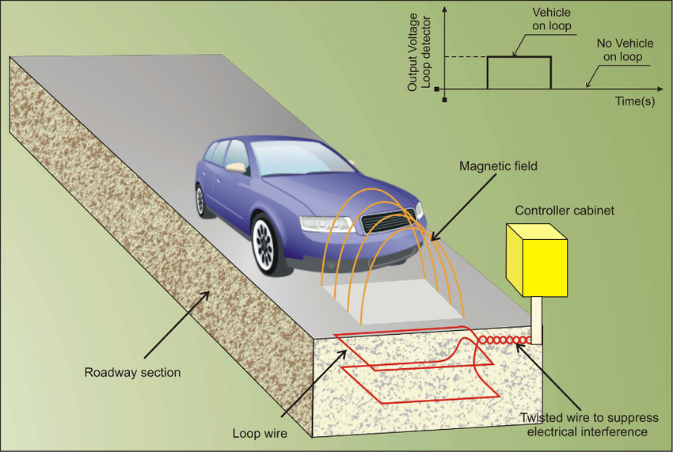
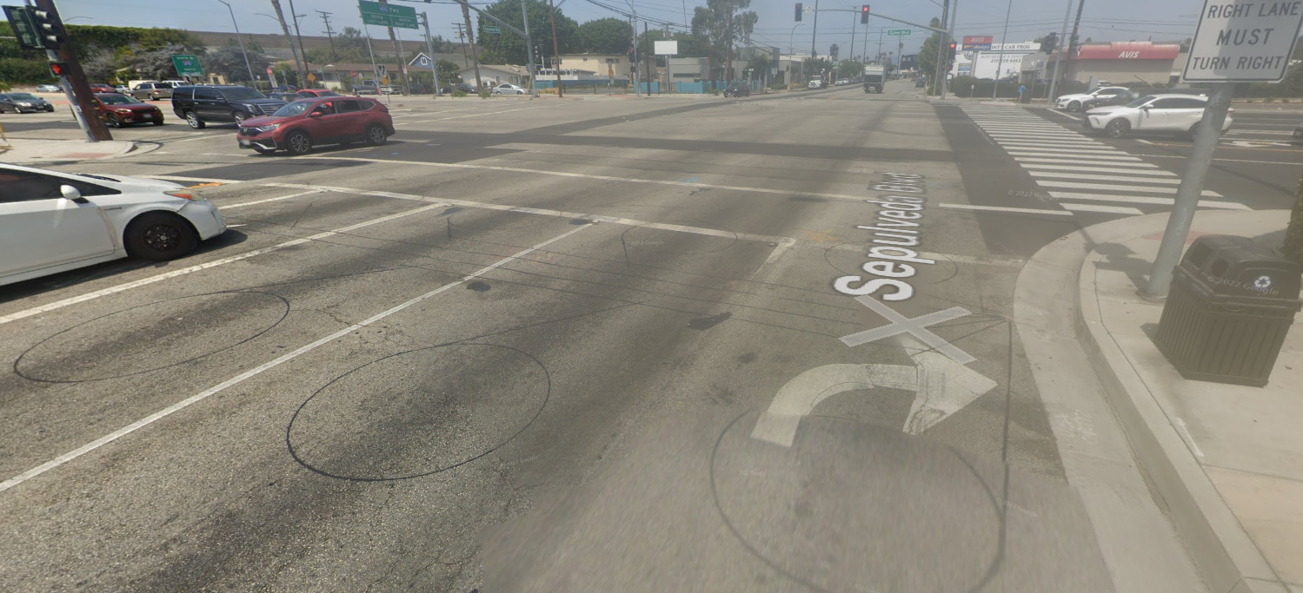
TYPES OF DETECTION
Passive
Inductive Loops

Slide 5
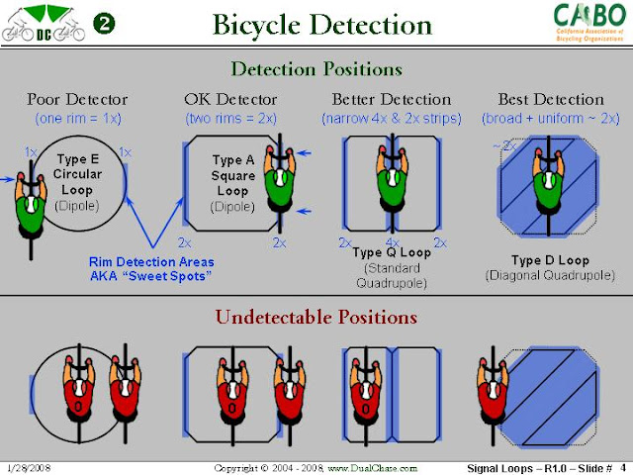
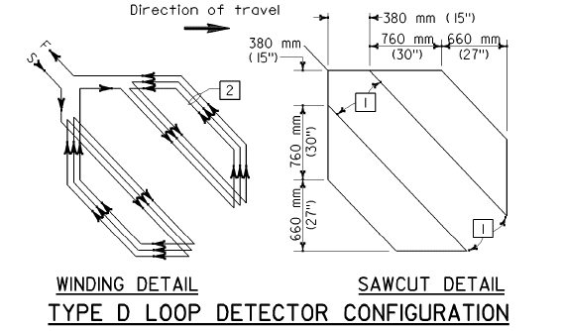
TYPES OF DETECTION
Passive
Inductive Loops

Slide 6
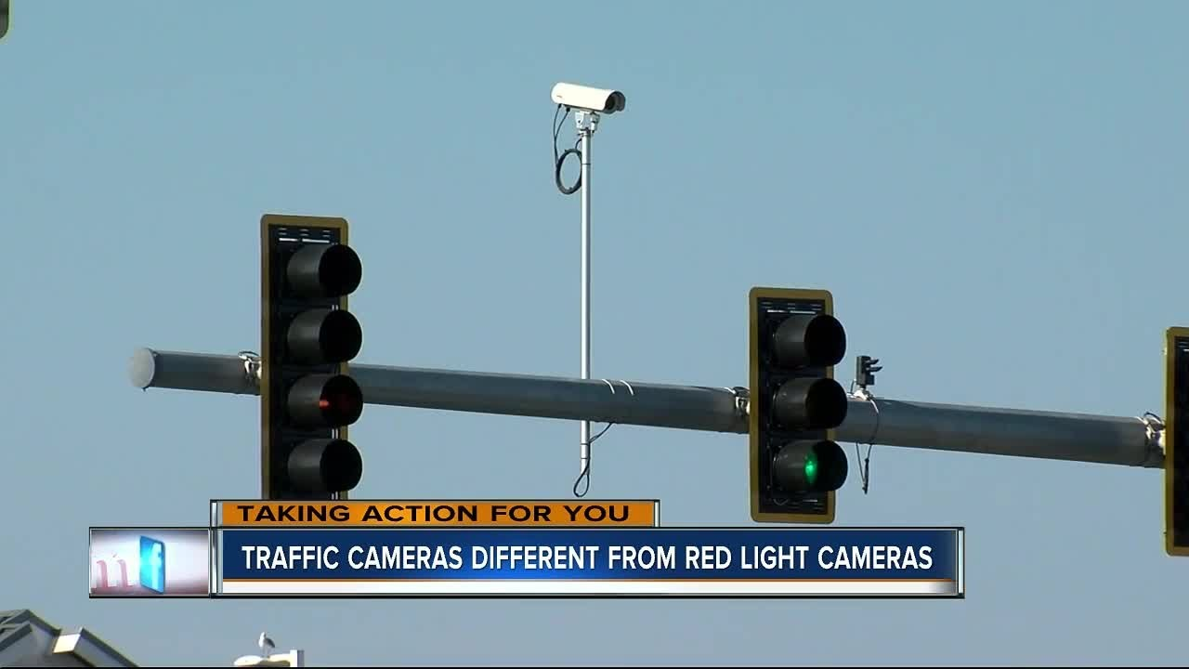
TYPES OF DETECTION
Passive
Video Detection

Slide 7
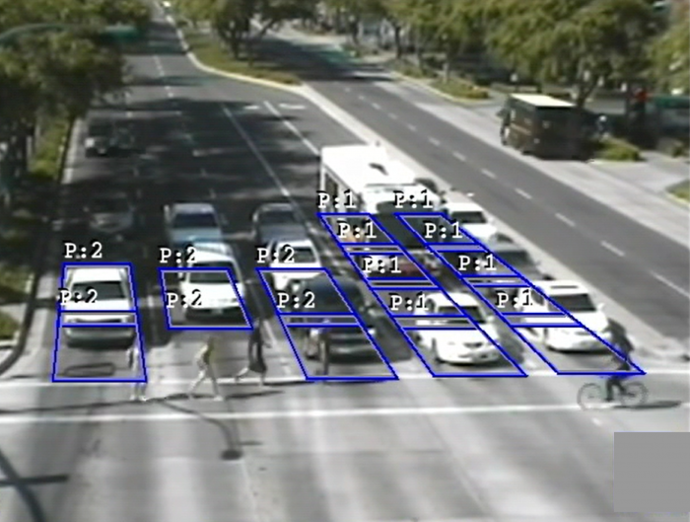
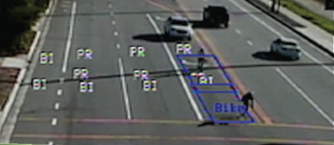
TYPES OF DETECTION
Passive
Video Detection

Slide 8
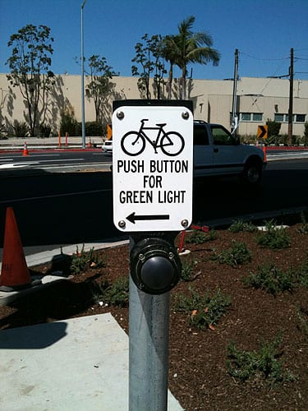
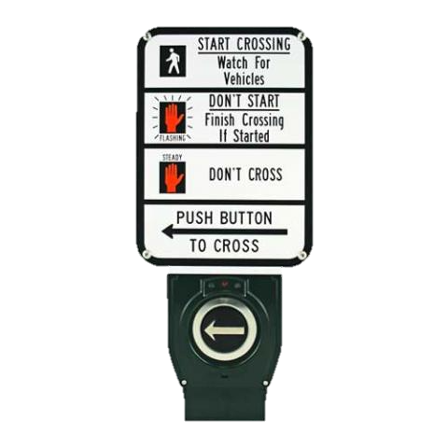
TYPES OF DETECTION
Active
Push Buttons

Slide 9
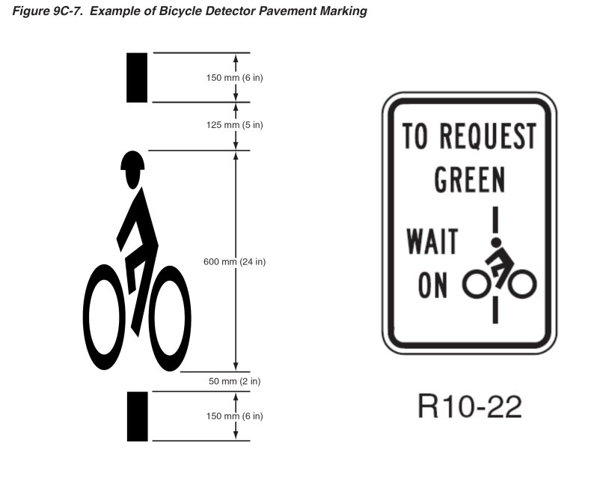
Signs & markings

Slide 10
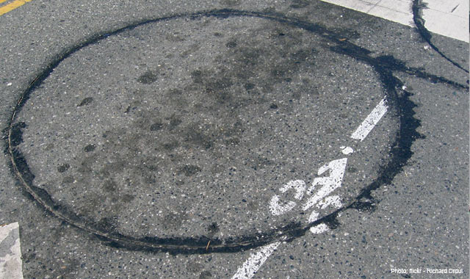
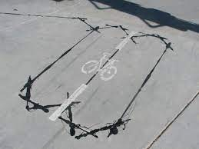
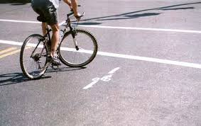
Signs & markings

Slide 11
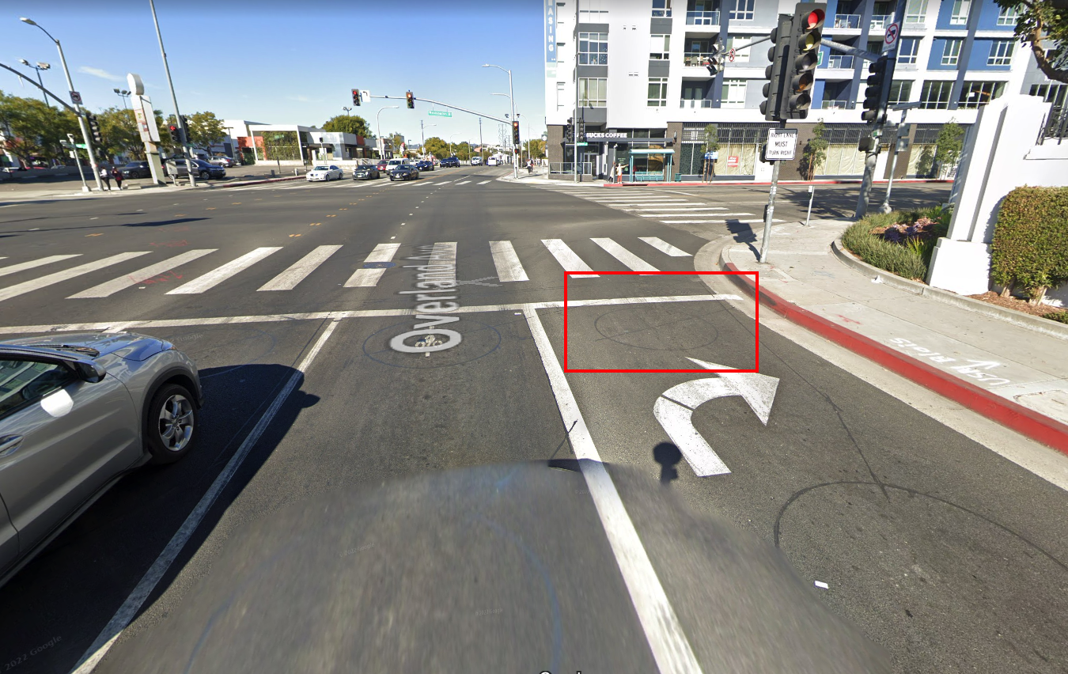
Examples in Culver city

Slide 12
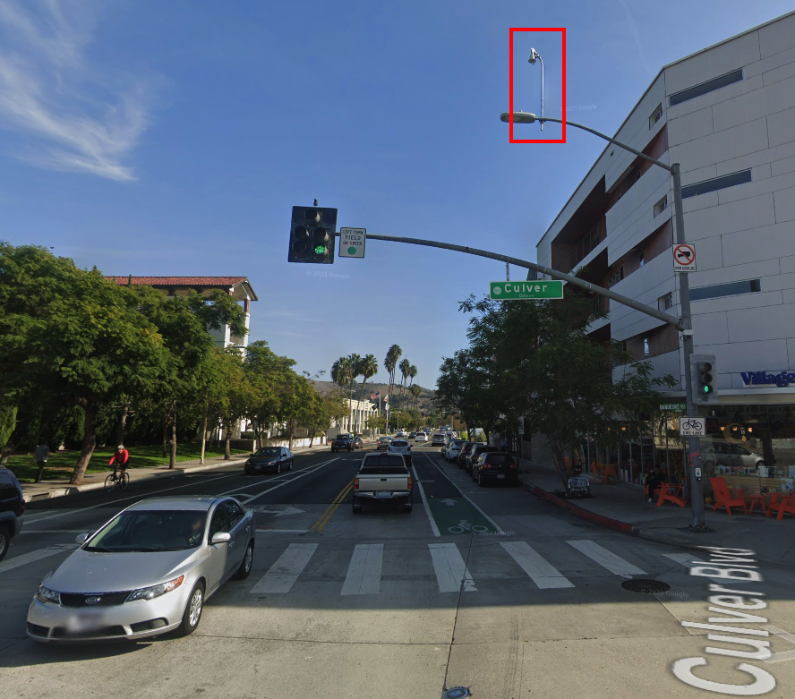
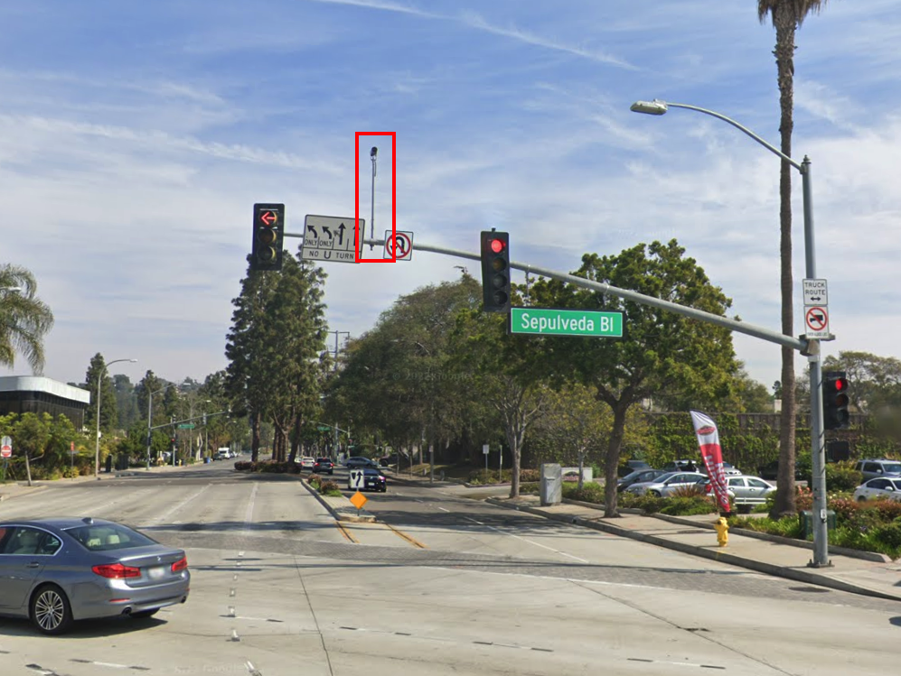
Examples in Culver city

Slide 13
Questions?

