Slide 1
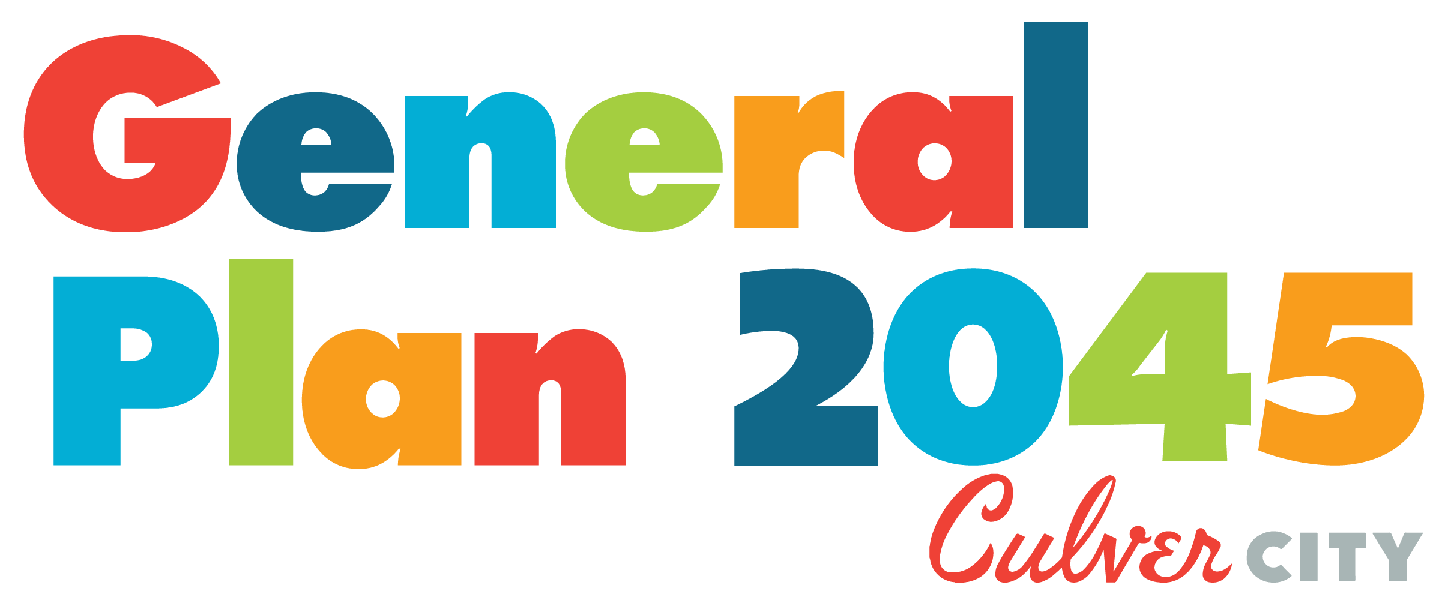
Mobility Element

Slide 2
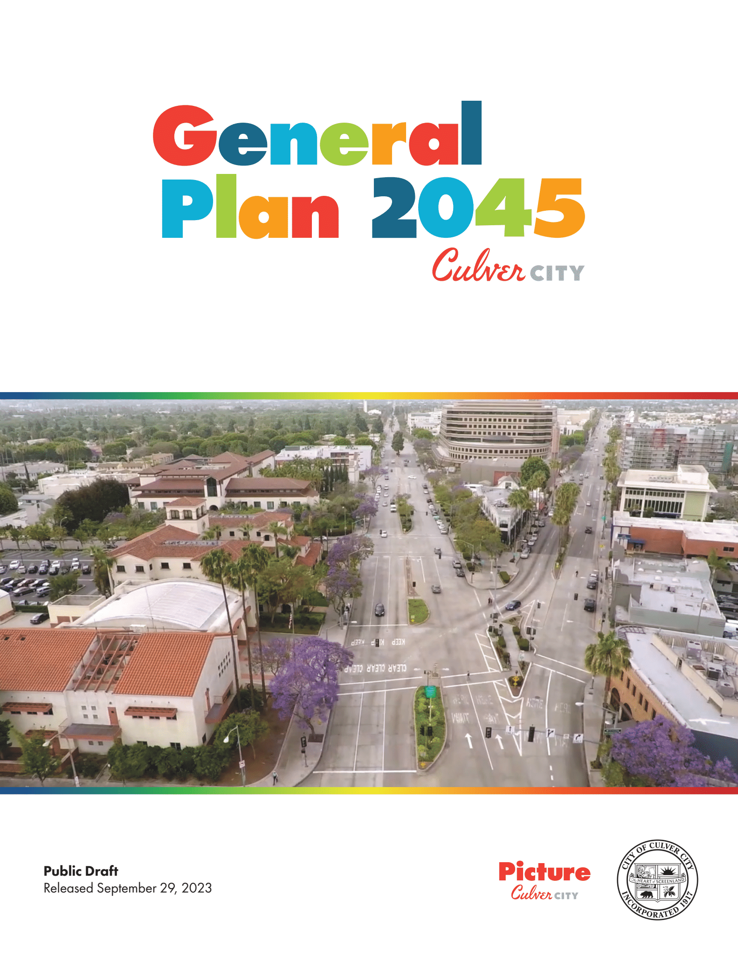
Background
The General Plan sets the vision for the city over its 20-year span
The twelve elements that make up the plan include goals and policies to implement the vision
The GPU process began in 2019
  Community Health and Environmental Justice
  Governance and Leadership
  Arts and Culture
  Land Use
  Parks, Recreation, and Public Facilities
  Economic Development
  Infrastructure
  Mobility
  Greenhouse Gas Reduction
  Conservation
  Safety
  Noise

Slide 3
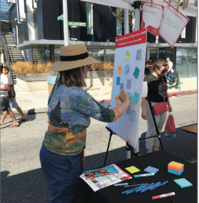
Outreach Process
Speaker series, community workshops, pop-up events
19 General Plan Advisory Committee meetings, 20 total Technical Advisory Committee meetings
Stakeholder meetings, City Council and Planning Commission meetings
Several surveys, including 2 dedicated to land use and mobility
3 meetings of the Transportation and Mobility Technical Advisory Committee
Notes:
BPAC Chair was on Mobility TAC

Slide 4
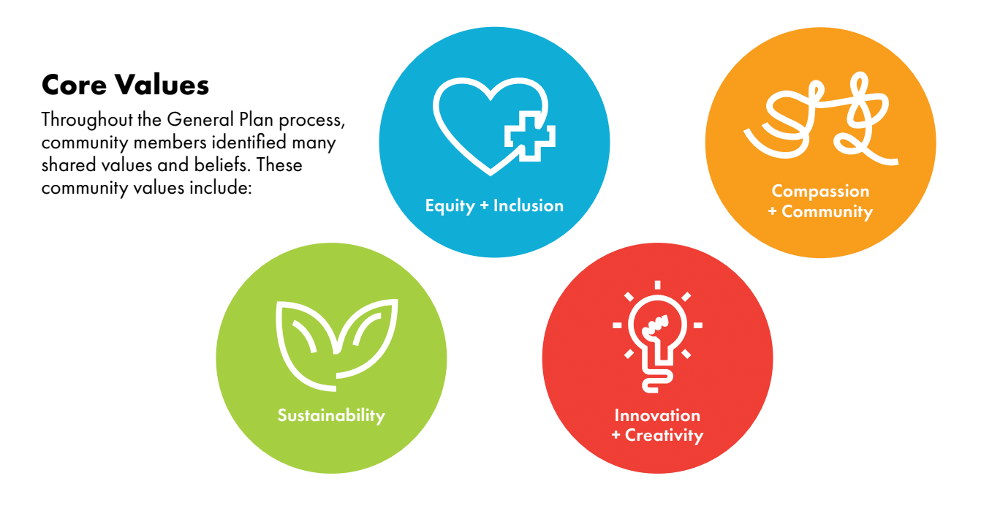
Plan Values + Mobility Goals
The Mobility Element’s goals include:
  Increasing bike and pedestrian trips and use of transit
  Reduction of greenhouse gas emissions and Vehicle Miles Traveled (VMT)
  Increasing safety and connectivity
  Equitable and reliable access to schools and key destinations
  Attractive, sustainable mobility options for all
  Elimination of severe injuries and fatal collisions, and reduction of collision rates on the city’s roads

Slide 5
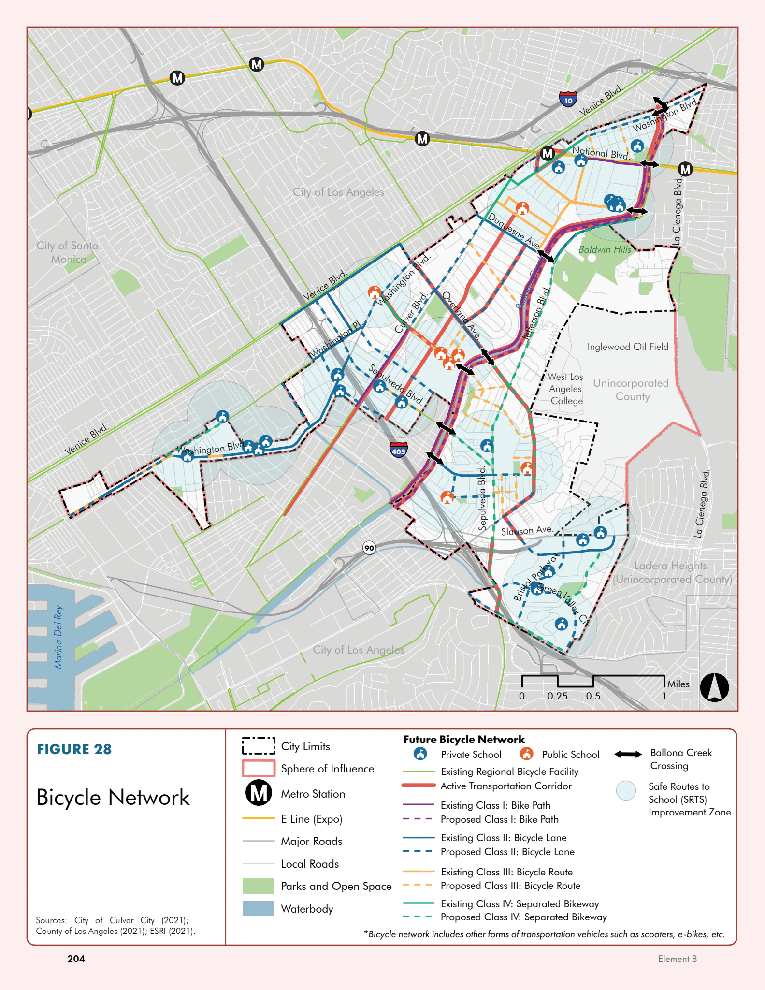
Bicycle Network Map
The Ballona Creek path is the backbone of the bike network
Existing and new bike paths by type
Connections to schools and other landmarks

Slide 6
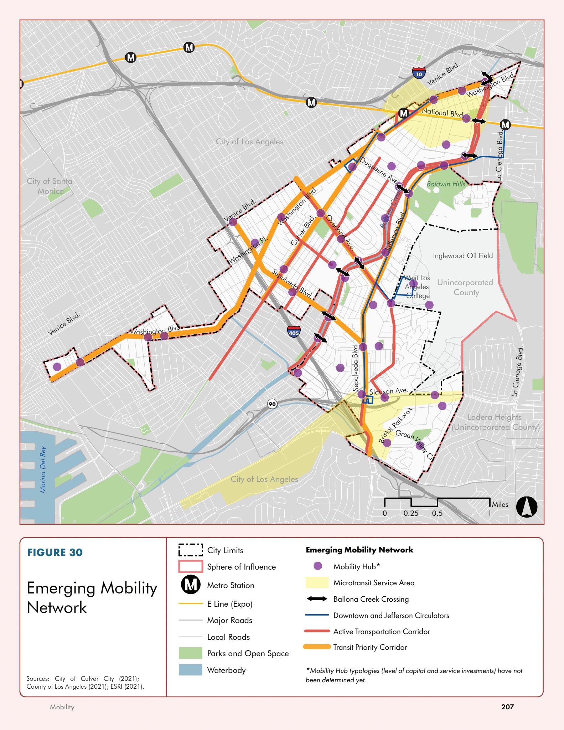
Mobility Network Map
Mobility hubs would be classed and could include park and ride facilities, carshare, bike and scooter share stations and storage, improved bus stop amenities such as shelters and bus timing

Slide 7
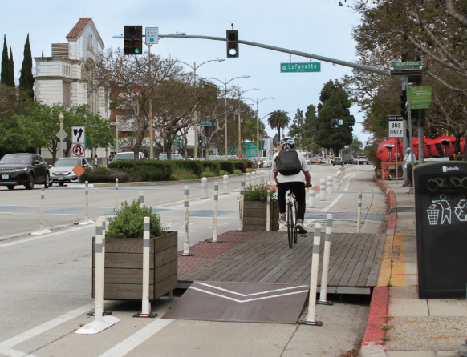
Mobility Goals + Policies
Goal M-1, Safety: A transportation network that is safe and accessible for all travel modes and people of all ages, physical abilities, and financial means.
Goal M-2, Complete Streets: A layered transportation network that is complete and convenient for all travel modes and serves the greatest public good.
Goal M-4, Equitable access: A transportation system that provides affordable or free, equitable, and efficient access to employment center, residential communities, schools, and other essential services.
Goal M-5, Sustainable and accessible transportation system and transit-oriented communities: A sustainable and accessible transportation system that provides great multi-modal travel experience for residents, workers, and visitors through mobility planning, TDM, and transit-oriented districts, corridors, and developments

Slide 8
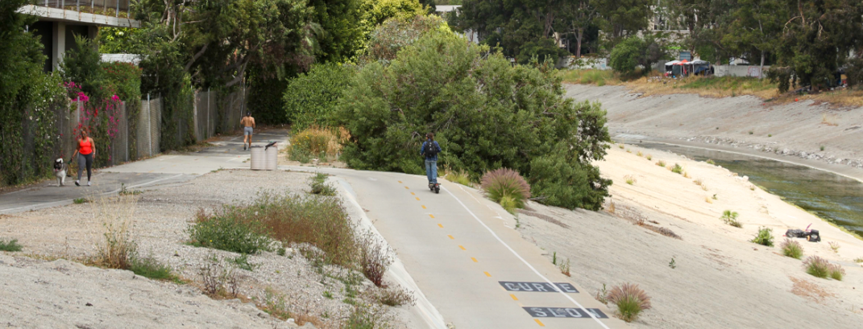
Mobility Goals + Policies
Goal M-6, Street and curb management: Streets are proactively managed to increase person-throughput on arterials and collectors while addressing passthrough auto traffic on local streets.
Goal M-8, Active transportation: An active transportation network that supports healthy living and expands access to social determinants of health.
Goal M-9, Ballona Creek: Ballona Creek is a safe, inviting, and accessible multi-use recreational and movement corridor.

Slide 9
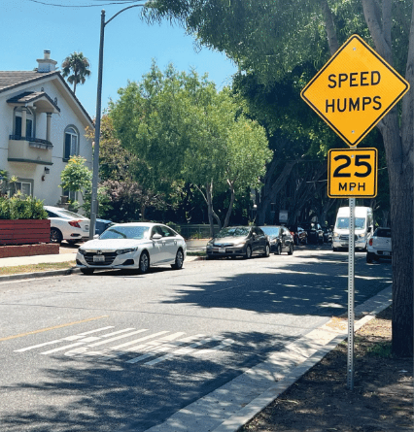
Implementation Actions
Safe Routes to Schools, for Seniors, and traffic safety education
Complete Streets guidelines
Neighborhood Traffic Management to reduce volumes and speeds on residential streets, enhancing safety and experience for cyclists and pedestrians
Considering street and parking space reallocation
Funding priorities
Ballona Creek improvements – signage, lighting, design, ramp access

Slide 10
Bike + Ped Policies in Other Elements
Community Health + Environmental Justice: encourage improvements to Ballona Creek, increasing active transportation opportunities, and age-friendly streets for aging adults
Arts + Culture: encourages improvements to transportation access to arts & culture programming/venues
Land Use: transit-oriented communities, walkable development, encouraging bike/ped links between neighborhoods, reduction of auto-oriented uses downtown, pedestrian experience improvements
Parks, Recreation, + Public Facilities: park connectivity and accessibility, Ballona Creek improvements
Additional policies in Conservation, GHG Reduction, Safety

Slide 11
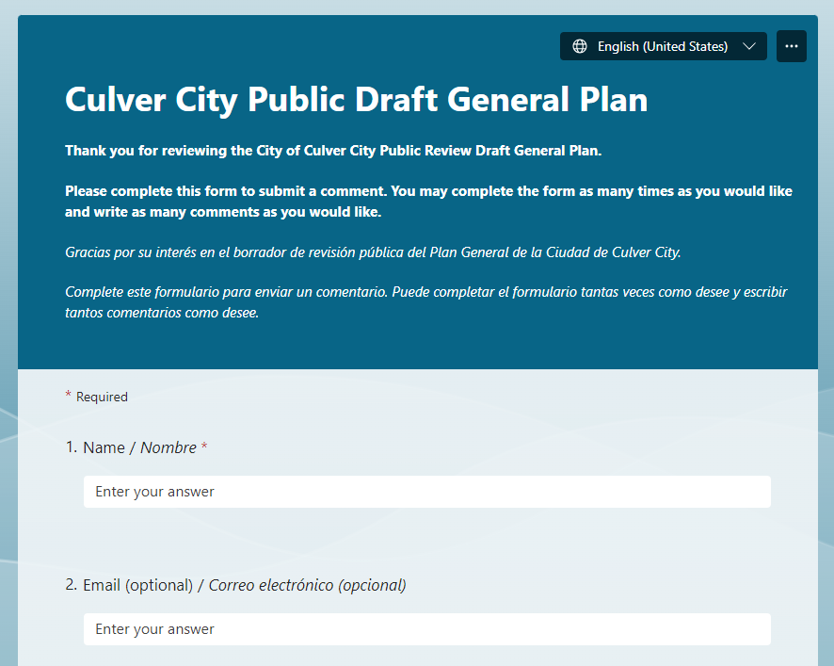
Comments + Timeline
The public comment form will be open through November 30th at www.pictureculvercity.com
The Environmental Impact Report (EIR) will be released in the winter/spring 2024
The update to the Zoning Code will be released in spring 2024
Adoption of the General Plan, EIR, and Zoning Code Update is planned for spring/early summer 2024

Slide 12

Questions + Thank you

