Slide 1

Robertson Blvd Bike and Bus Lane Project
Bicycle & Pedestrian Advisory Committee Meeting
April 18, 2024
Item A-3
Public Works Department
Mobility & Traffic Engineering Division

Slide 2


Metro Active Transportation (MAT) Grant
Grant received Jan 2021 – FA executed Aug 2022
Scope of work
  Class IV separated bikeway along Robertson Boulevard between Venice Boulevard and Washington Boulevard
  Bus only lanes along Robertson Boulevard
  Establishment of bus boarding islands
  Pedestrian improvements including lighting, sidewalks, crosswalks, ADA compliant curb ramps, canopy trees, and street furniture
Robertson Blvd Bike and Bus Lane Project

Slide 3
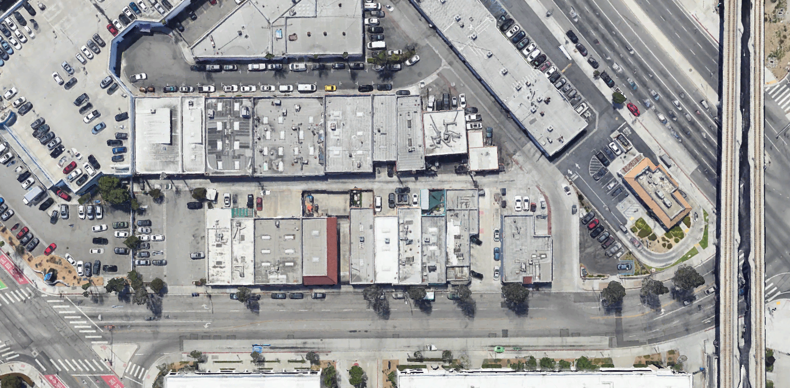
Existing Parking
Robertson Blvd
West Side
On-Street Meters
7 - 10-Hour
2 - 30-Min
Robertson Blvd Bike and Bus Lane Project

Slide 4
Existing Parking
North Willat/Hoke Lot
7 - 10-Hour
1 - Blue
Robertson Blvd Bike and Bus Lane Project

Slide 5
Existing Parking
South Willat/Hoke Lot
19 spaces
Permit only
Robertson Blvd Bike and Bus Lane Project

Slide 6
Existing Parking
Willat Alley
22 spaces
Non-metered
Robertson Blvd Bike and Bus Lane Project

Slide 7
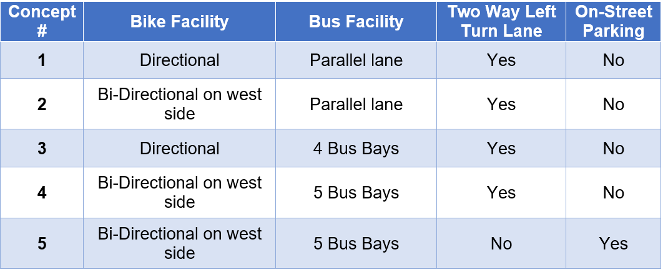
Conceptual Plans
Robertson Blvd Bike and Bus Lane Project

Slide 8
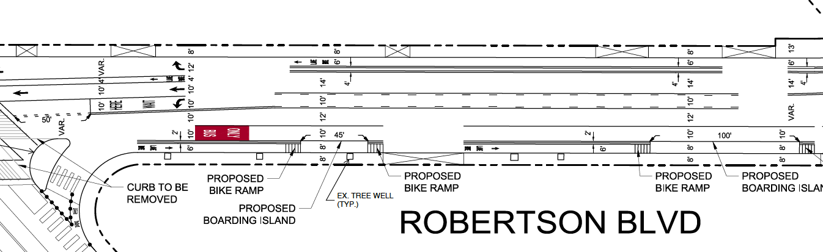
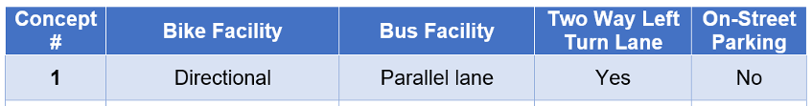
Concept 1
Robertson Blvd Bike and Bus Lane Project

Slide 9
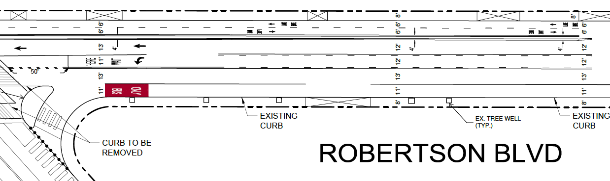
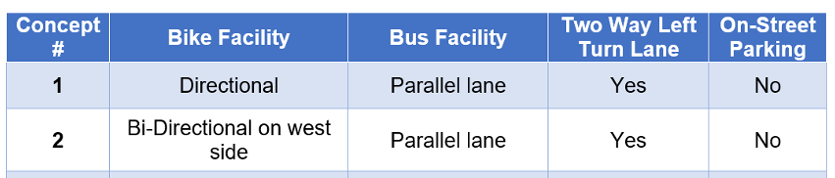
Concept 2
Robertson Blvd Bike and Bus Lane Project

Slide 10
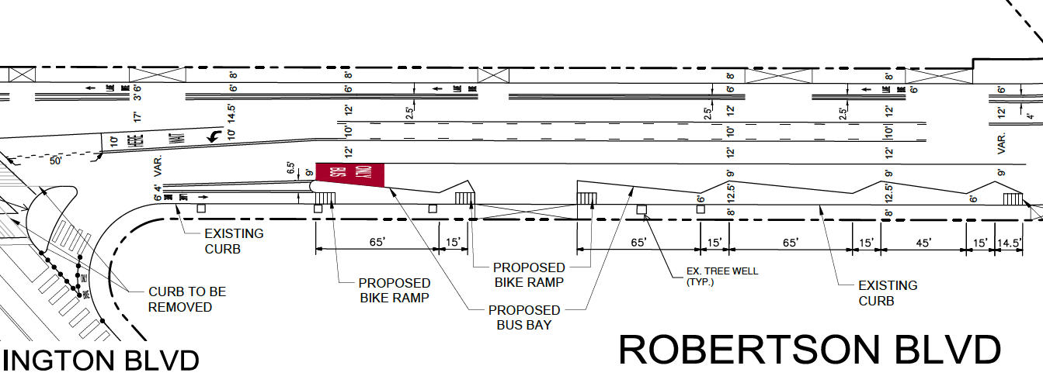
Concept 3
Robertson Blvd Bike and Bus Lane Project

Slide 11
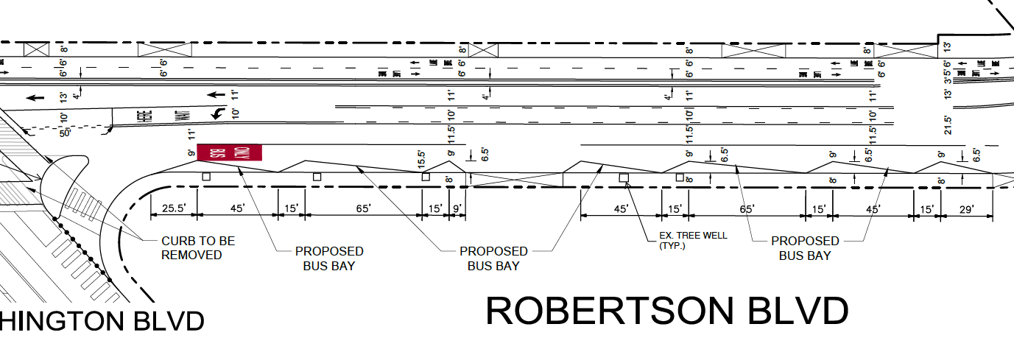
Concept 4
Robertson Blvd Bike and Bus Lane Project

Slide 12
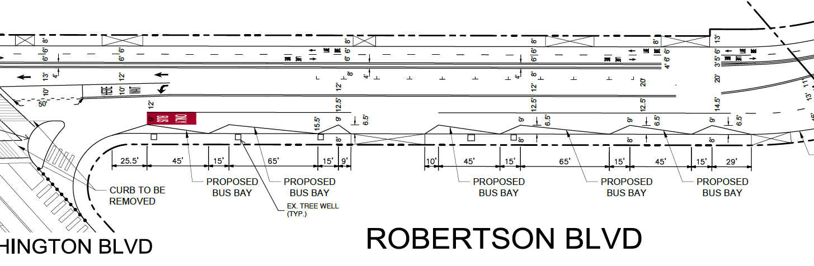
Concept 5
Robertson Blvd Bike and Bus Lane Project

Slide 13
Questions?

