Slide 1



Sept 27, 2022
PRESENTATION
CULVER CITY SUSTAINABILITY COMMITTEE
Environmental Sustainability Committee (ESC)
Sandrine Cassidy – CCUSD Environmental Sustainability Coordinator
sustainability@ccusd.org

Slide 2


The ESC
Environmental Sustainability Committee (ESC): stakeholder members
Foster the development of a diverse, active, and more equitable community
Continually work on improving areas of focus that benefit our micro and macro systems, with short-term and long-term benefits
Build awareness of sustainability issues to all stakeholders
Help prepare the student body to become eco-literate and engaged global citizens. Now they are leading us!

Slide 3
The ESC
Meets monthly (all stakeholders): 190 members, w/ ESC liaisons in each school
Produce green tip every week (CulverPride)
Our main focus:
  Operations: Working with head staff to improve general efficiency in energy, waste and water use (save $)
  Education: provide opportunities to strengthen educational programs about the environment by supporting green initiatives (students, parents, teachers, clubs…)
www.ccusd.org/sustainability

Slide 4

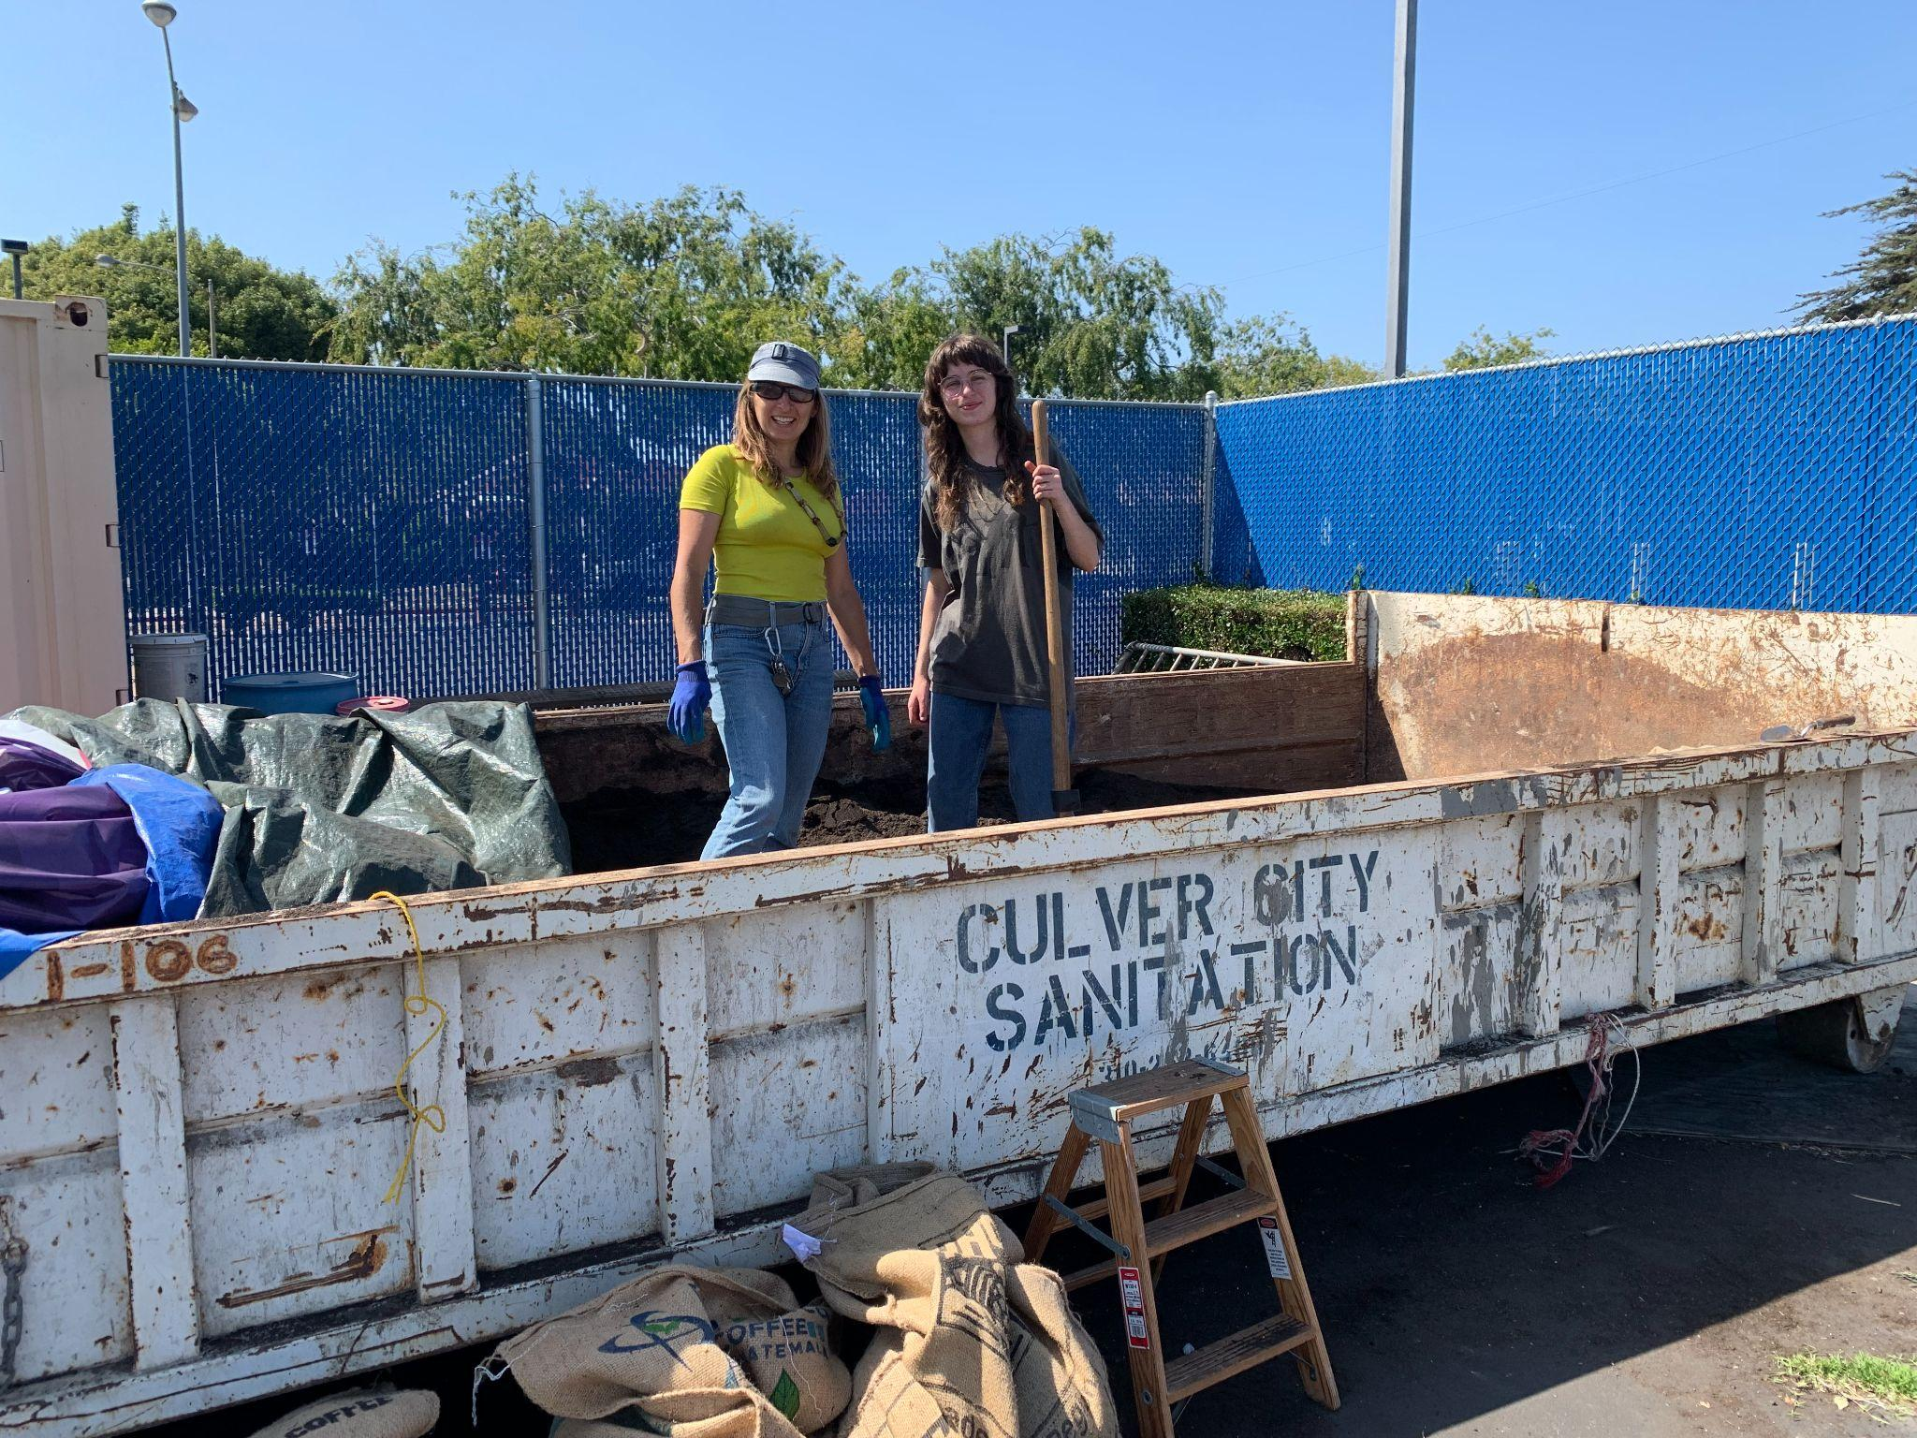
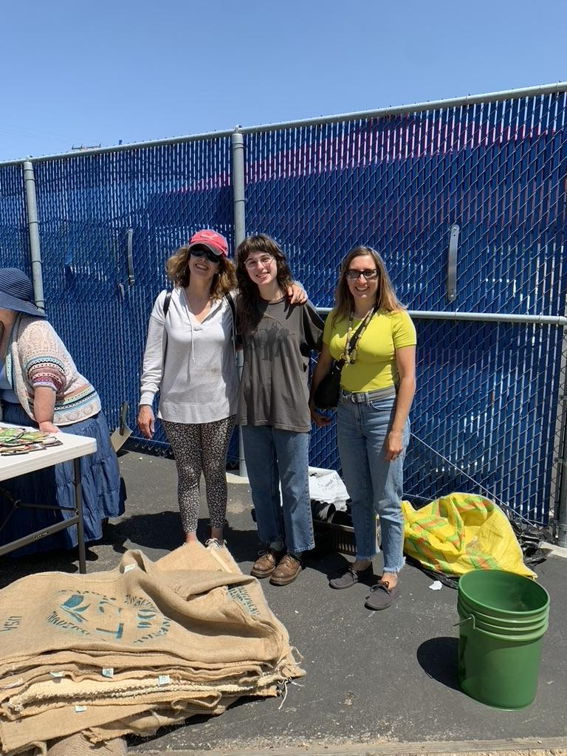
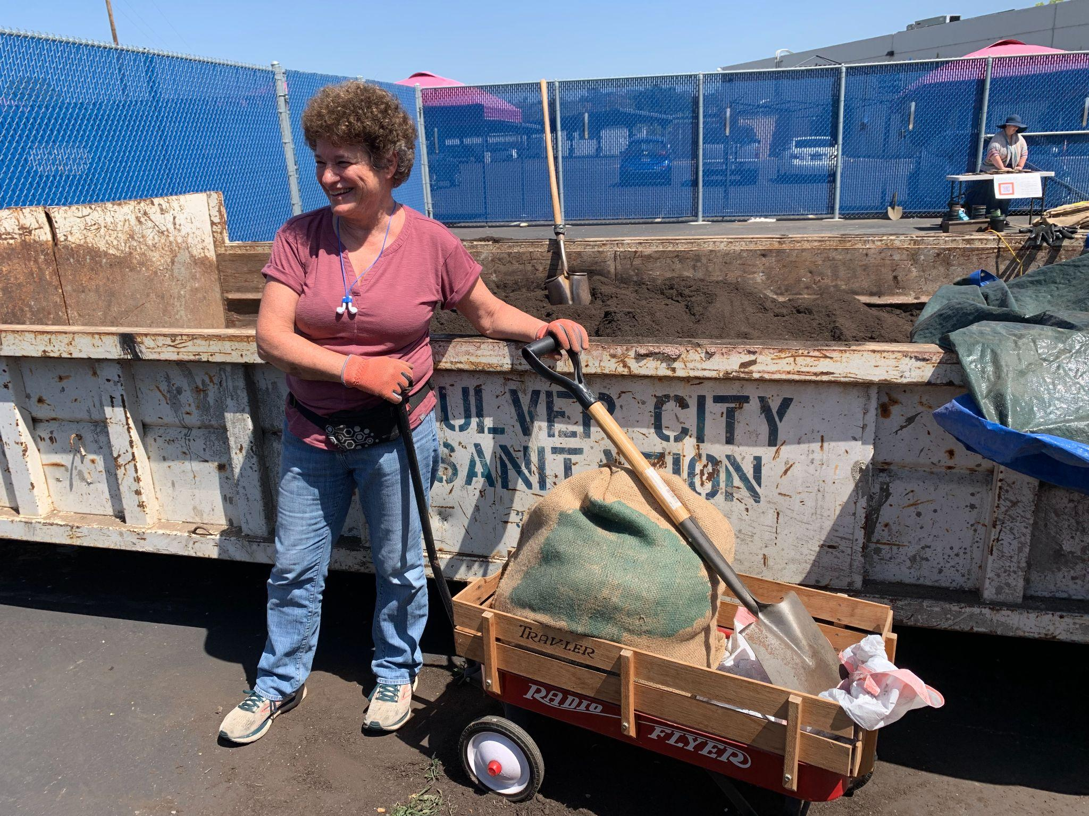
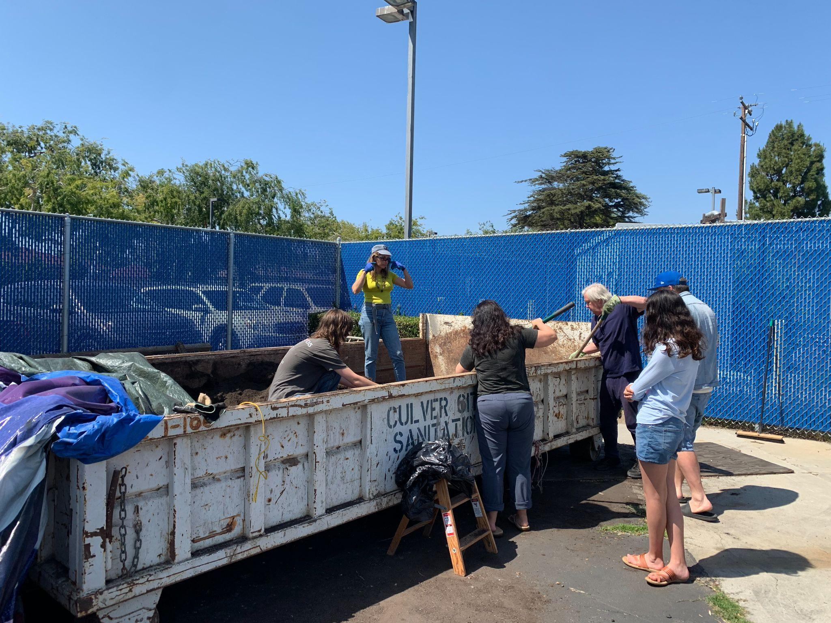
Coordinator’s update - Education
Rotary Community Grant: partnership with CCEF, awarded $10k to work on our CCUSD Green video AND $2500 from Ballona Creek Renaissance (importance/investment)
School Clubs: ASB, BCR HS Club, Human Rights Watch, Green Ambassadors, Garden clubs,...
Compost distribution event on May 7th: City EPO partnership. Congratulations Ava Frans (girl scout): 1 ton!

Slide 5
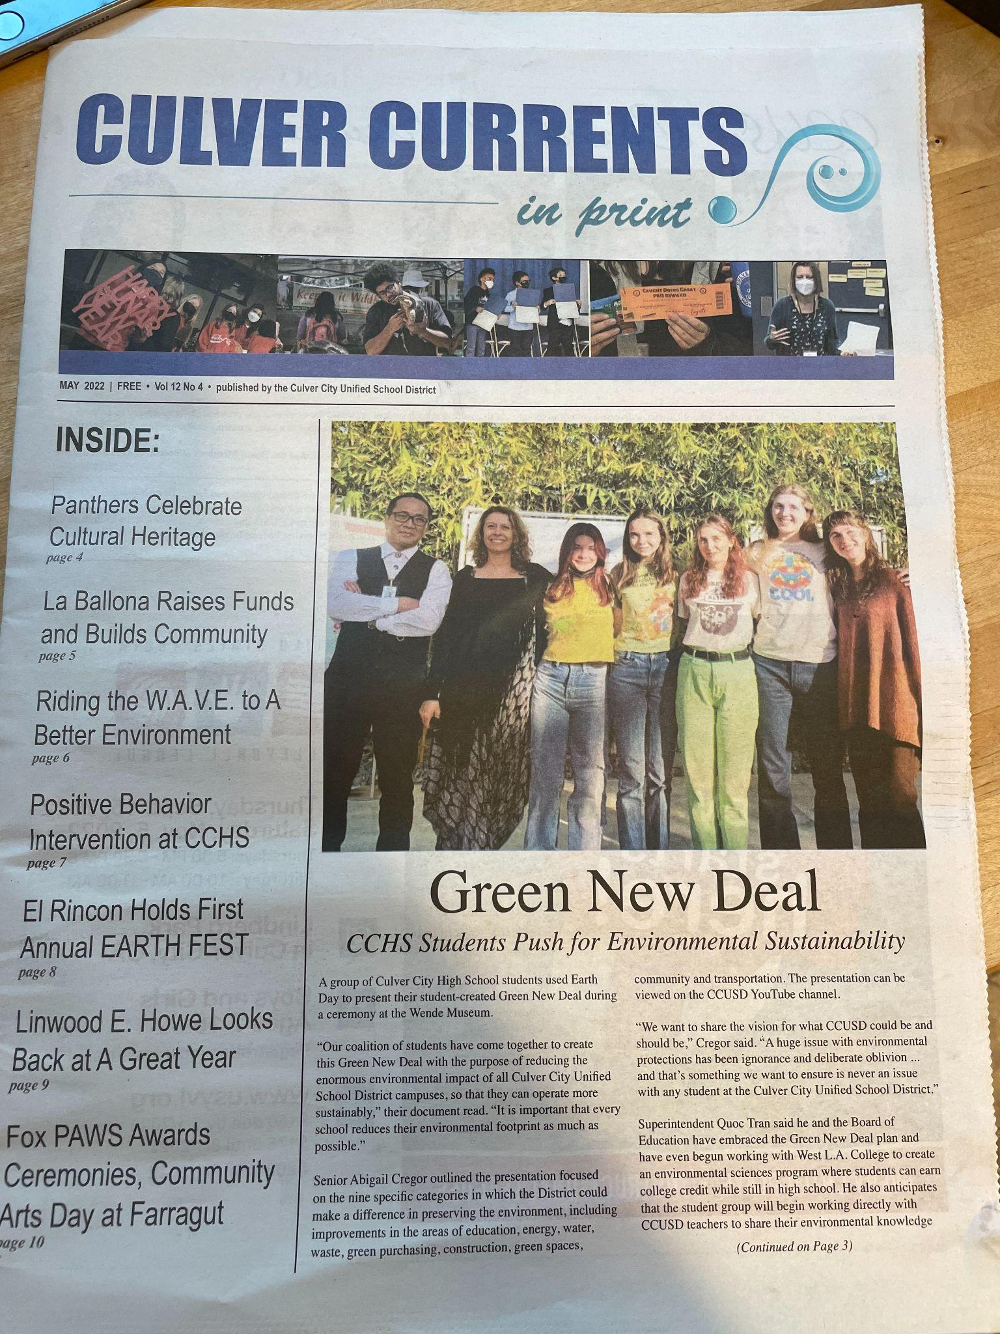
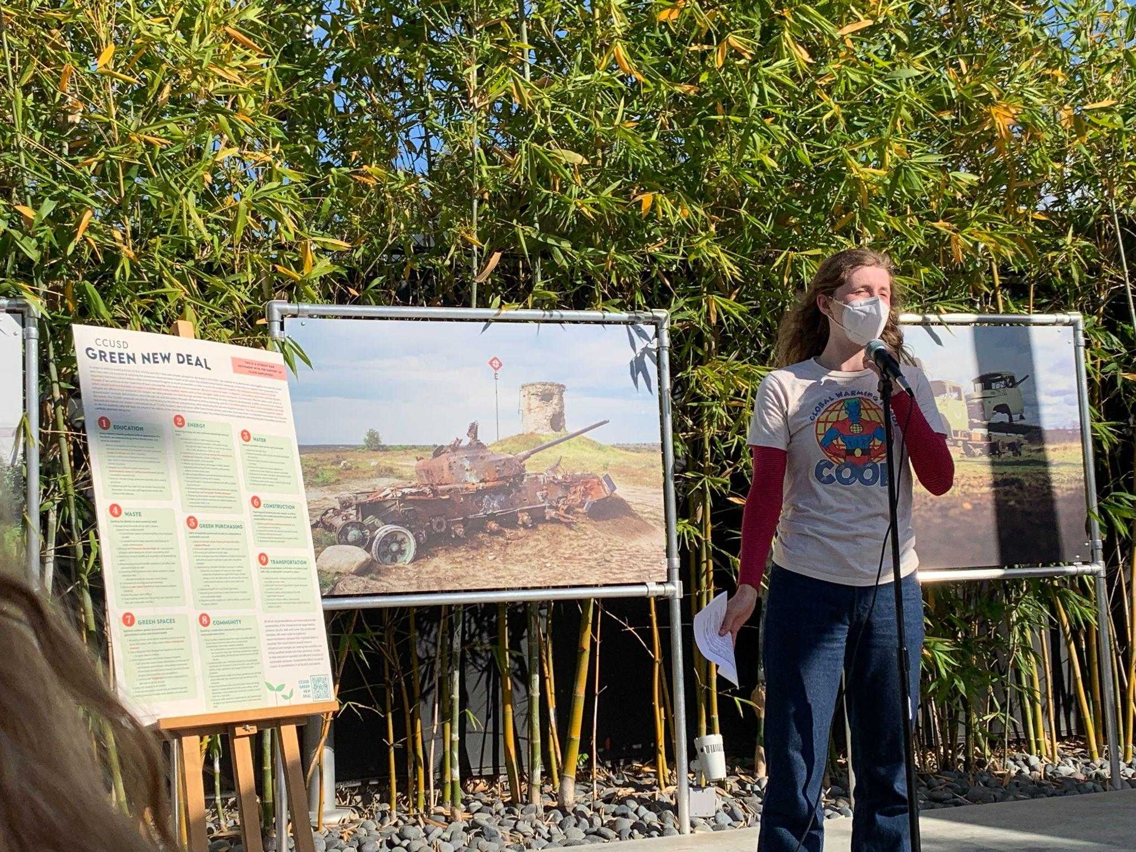
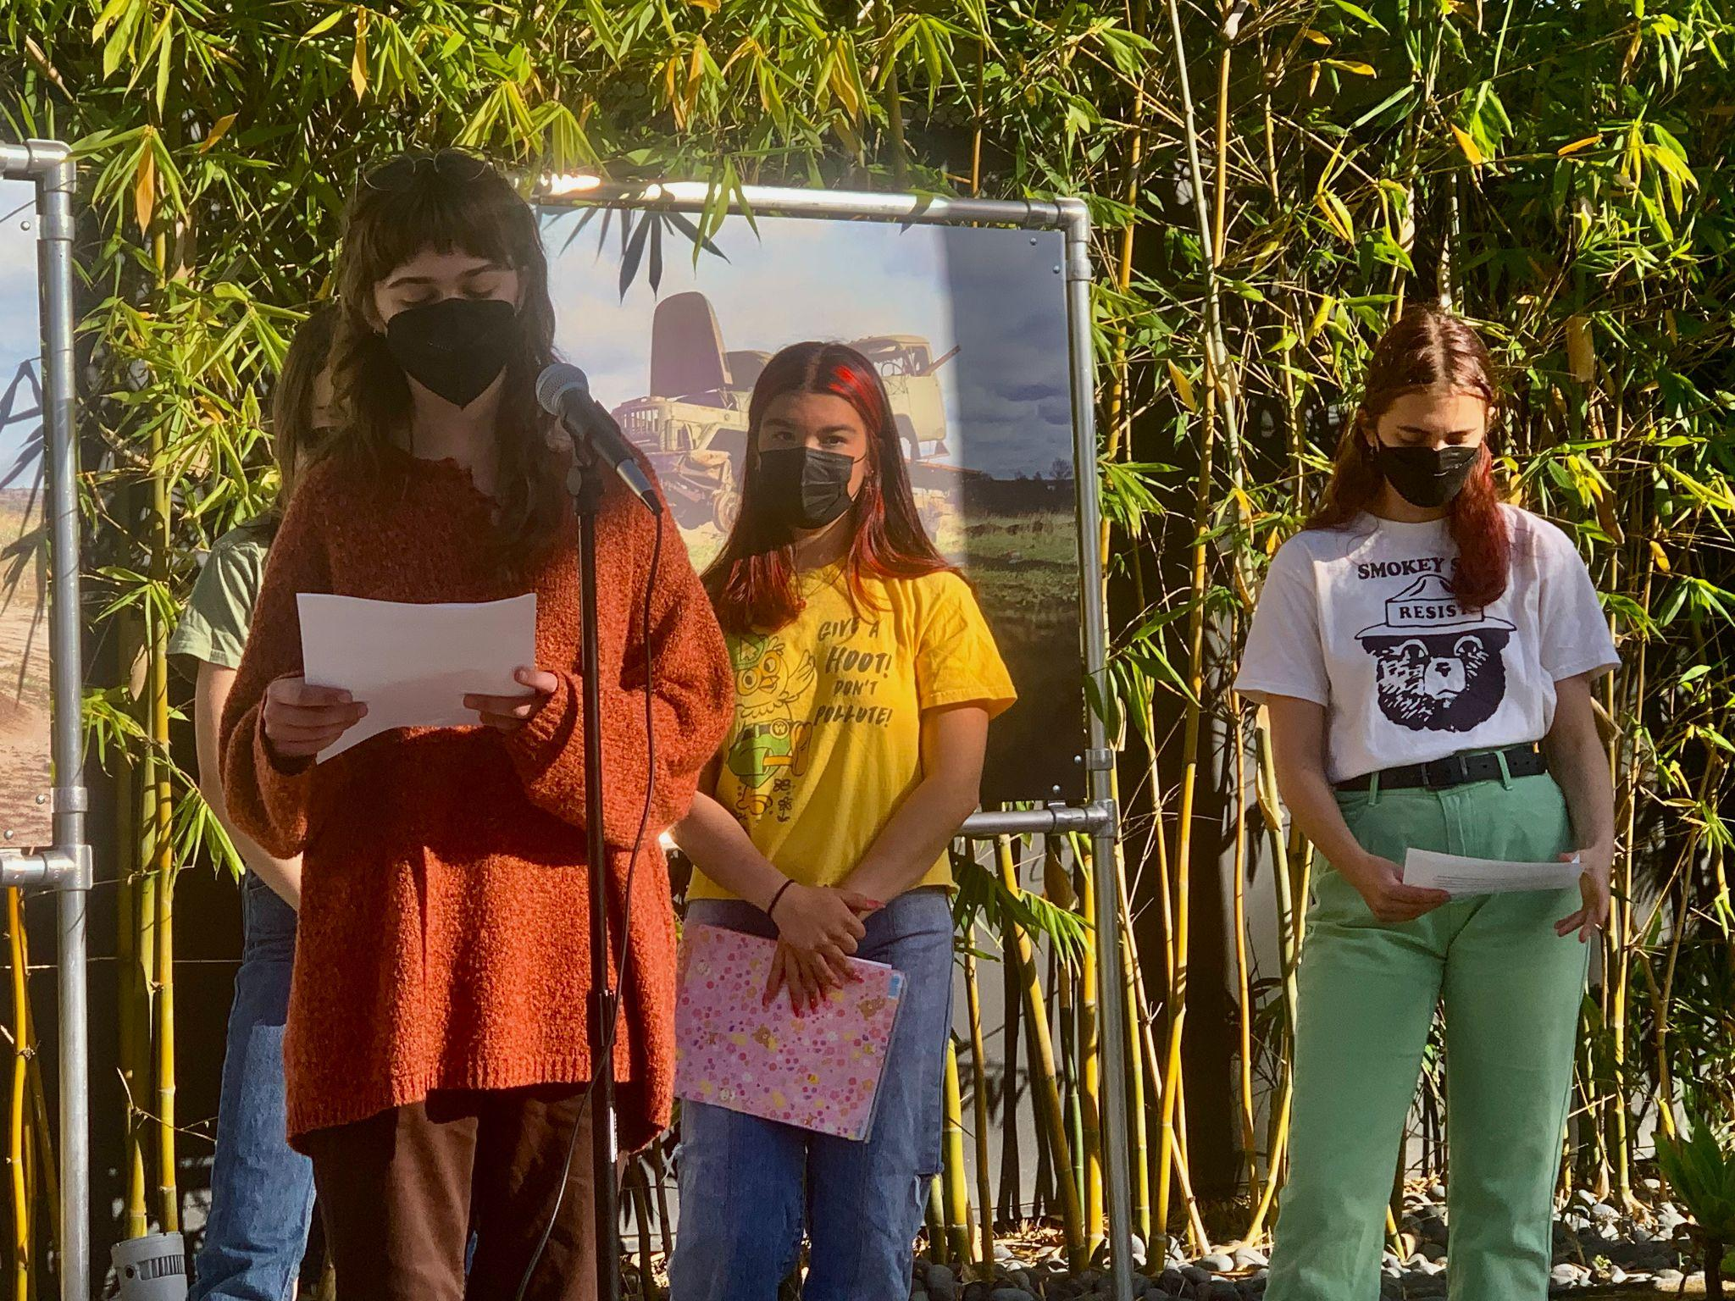
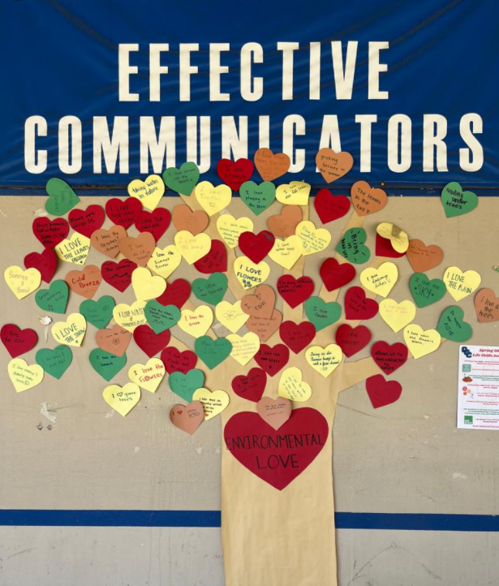
CCUSD Green New Deal
GND team: the GND will be part of the superintendent commitment. Official GND version was announced on Earth Day with City Council members, CCUSD Board members and guests
Grass Replacement Rebate Program with West Basin at CCHS

Slide 6
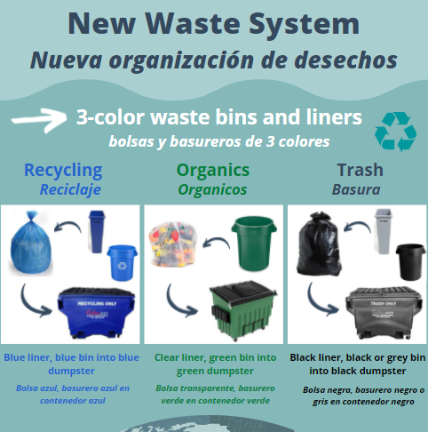

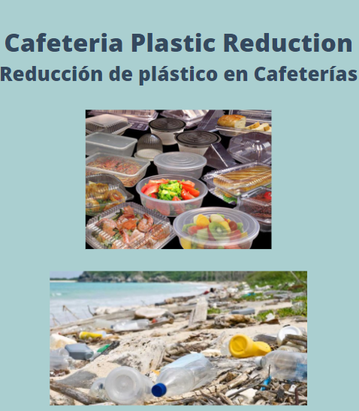
Green policies implementations
Hillyard list of products

Slide 7

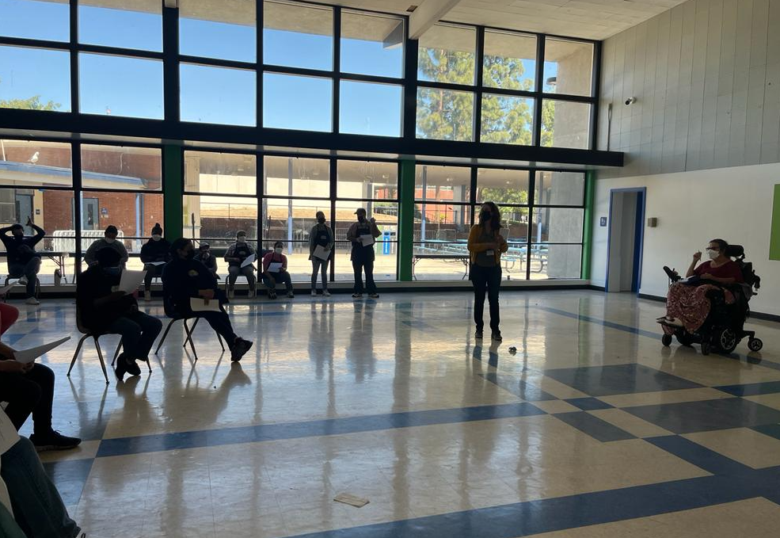
Coordinator’s update - Operations
Waste: we received the 3 color liners and have started custodians and cafeteria training; additional waste/recycling bins have been ordered; El Rincon video
Green Cleaning Products: feedback from custodians: no more headaches!!!
SoCal REN (Regional Energy Network): CCUSD is officially enrolled! They will help us to analyse utilities data (Energy Portfolio Manager), and enroll in available utility programs. (21st century)
Utilities online: better tracking.
Cafeteria Waste Reduction: NEW food/cafeteria
subcommittee; work in progress.

Slide 8
Coordinator’s update - Operations
Water Filling Stations: Purchased 2 new water filling stations with a West Basin Grant for La Ballona and Linwood Howe
Landscaping Survey: Performed at Linwood Howe to measure outdoor watering efficiency (Metropolitan Water Program)
Regional USD Coordinators platform (LBUSD; SMMUSD; SBUSD; LAUSD)
Utility User Tax (UUT): SCE crediting ~ $80K credited, with $80K saved for the years to come!
Electricity: District on 100% renewable energy (Human Right Watch Student task force)
ASB students make a recycling video

Slide 9
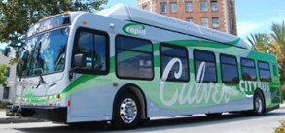
Free Bus Fare Program
Culver City Bus
As easy as 1-2-3
1. Pick up your Tap Card from Oscar Rodriguez, Assistant Principal
2. Register your tap card
  online at taptogo.net/fareless
  or call 866-TAPTOGO
3. Ride transit!
2 Year Pilot Project Updates
Unlimited free rides for students on buses and trains run by Culver City Bus + LA Metro
2,000 cards distributed for 7,000 students (57% in HS)
Total trips July 21 - April 22: 41,794, last quarter: 26,538!
Expanding to other School Districts and Community Colleges
ASB video here

Slide 10
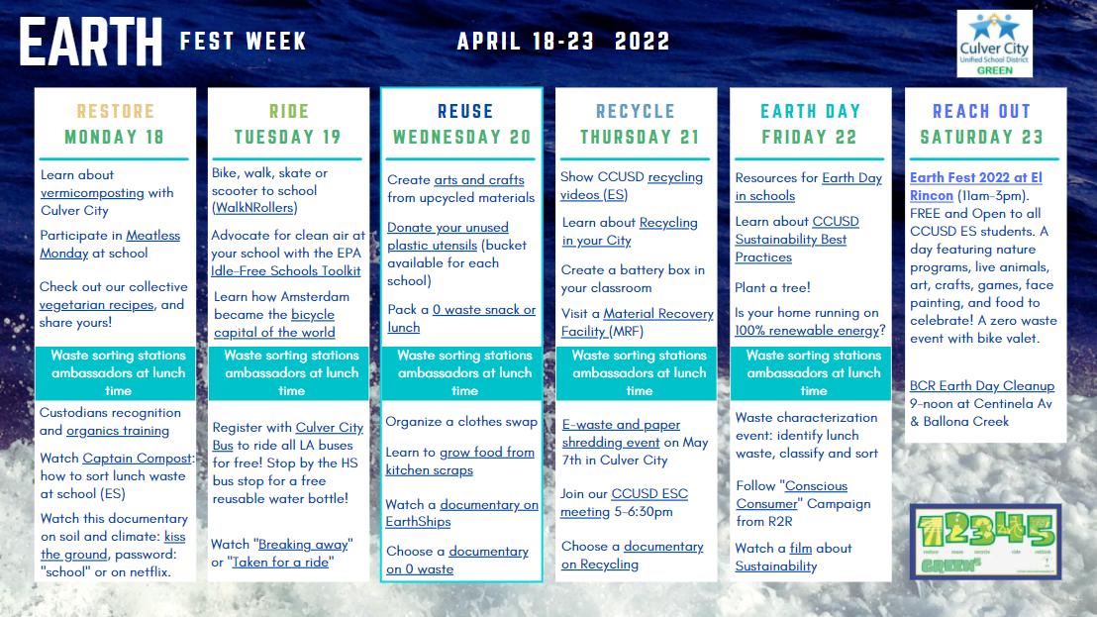
Earth Fest Week

Slide 11
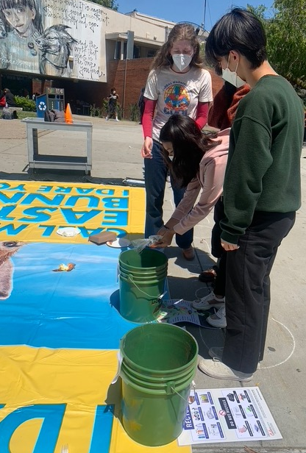
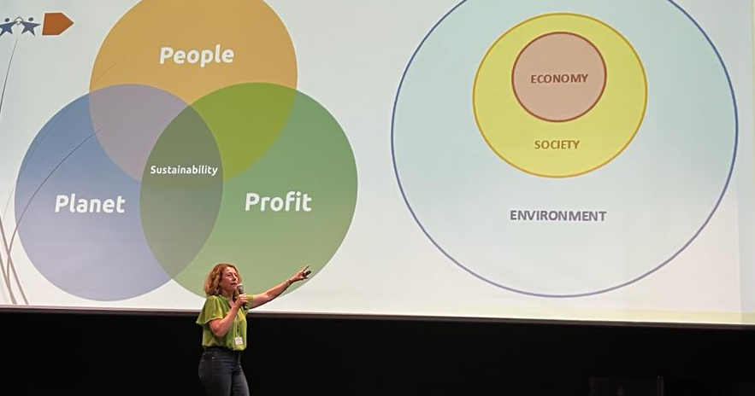
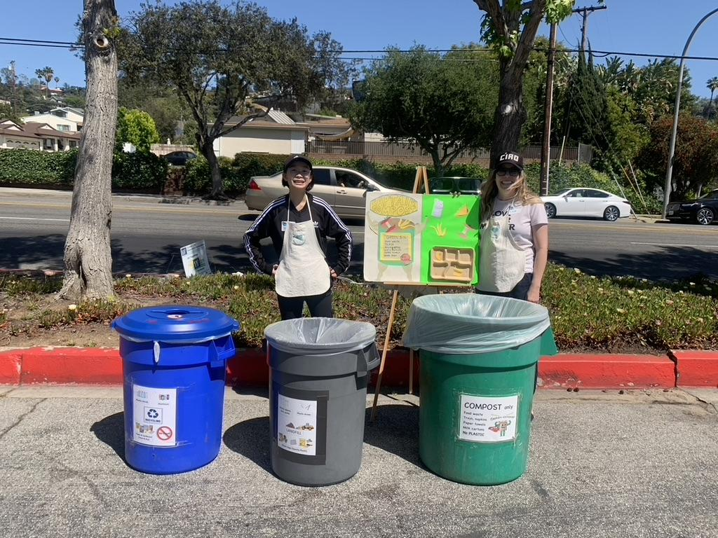
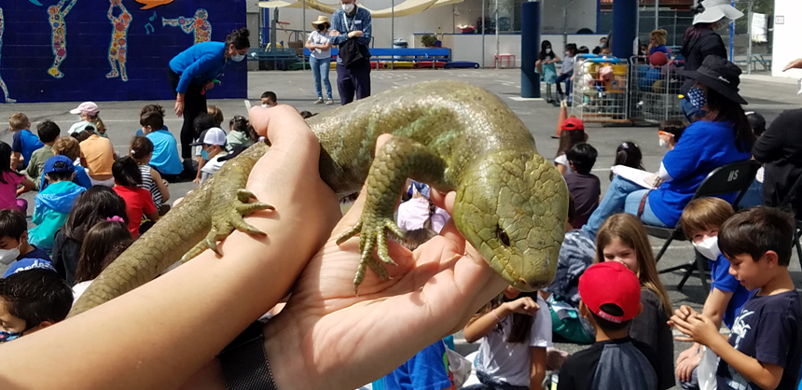
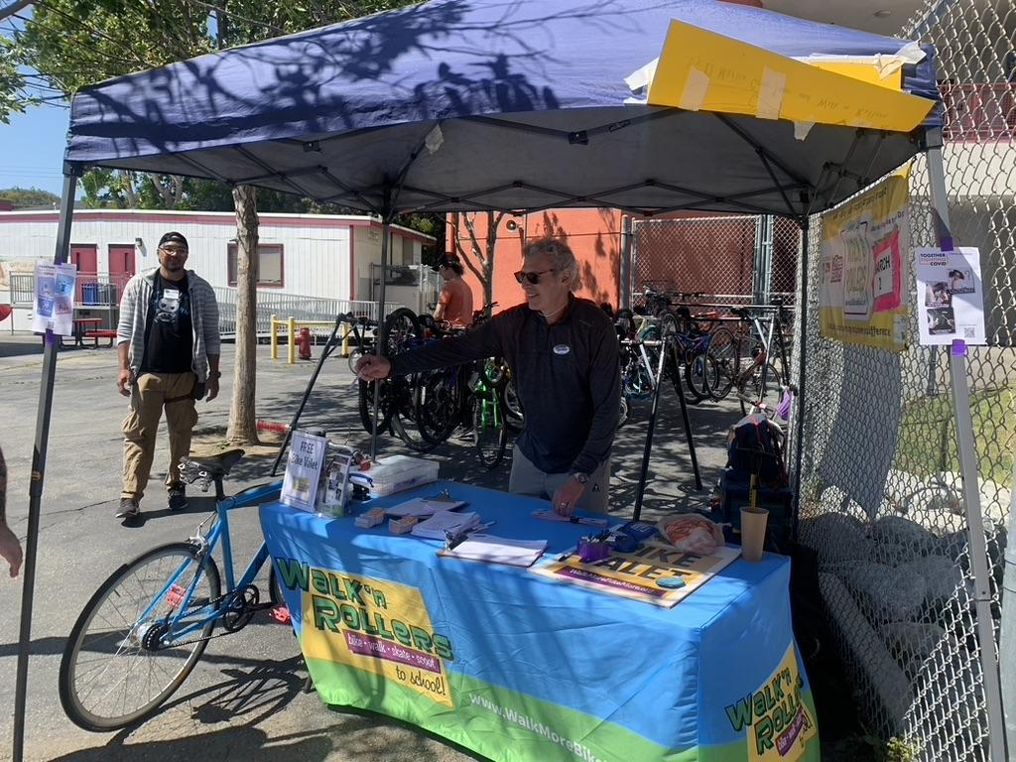
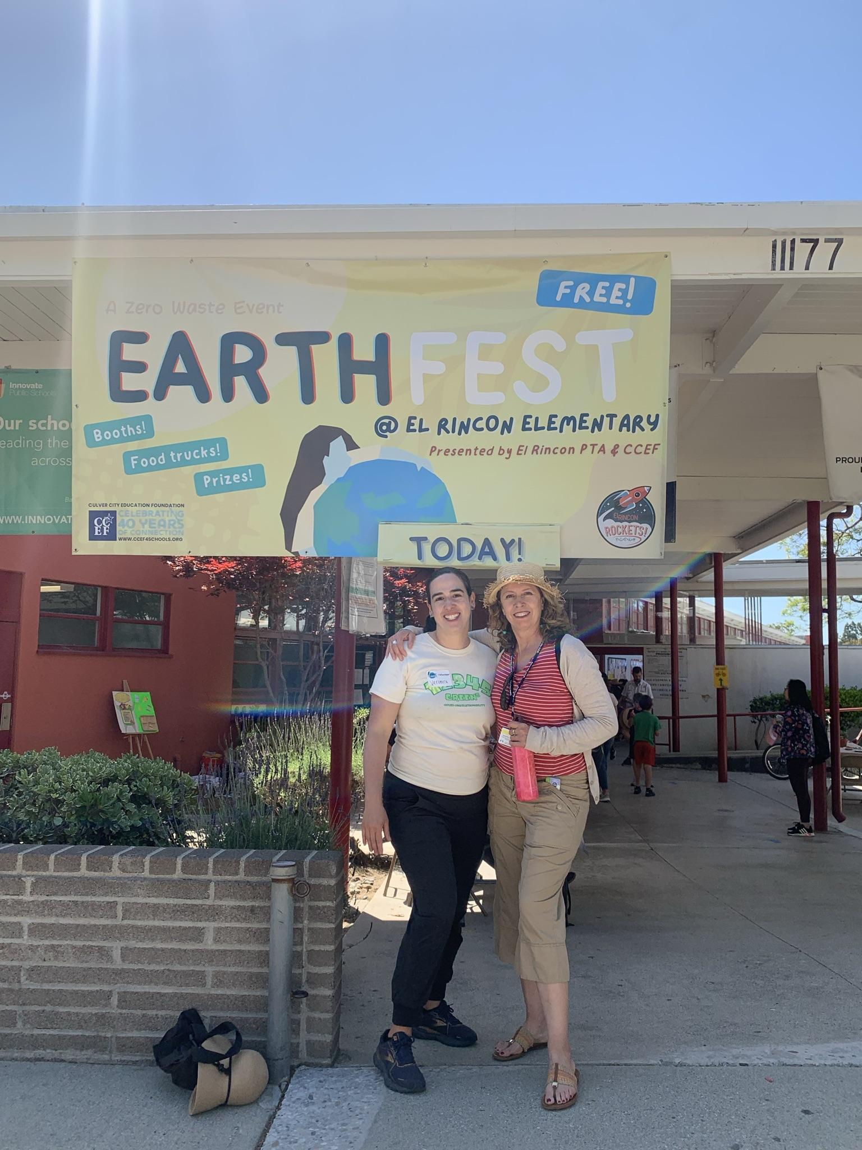
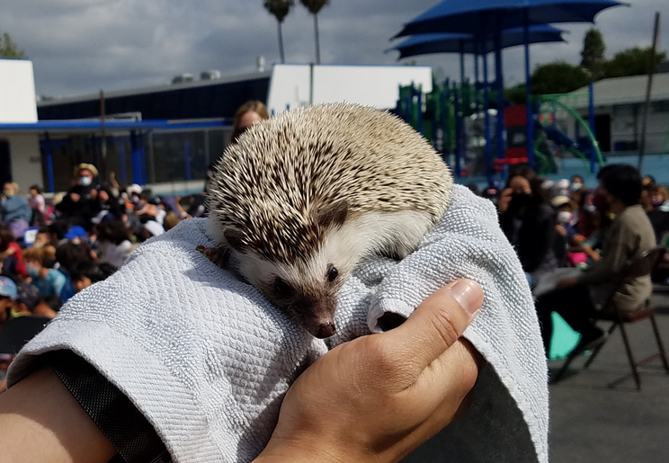
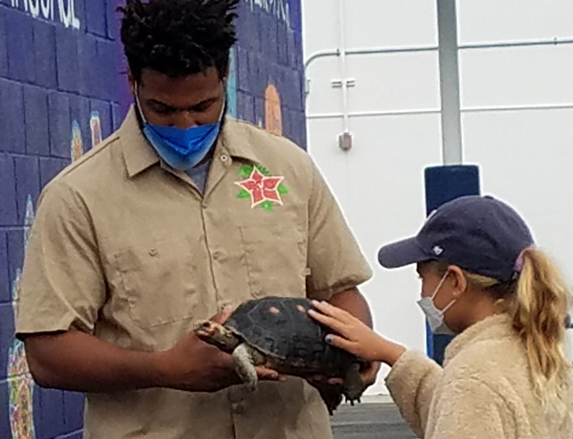
Earth Fest Week in pictures

Slide 12
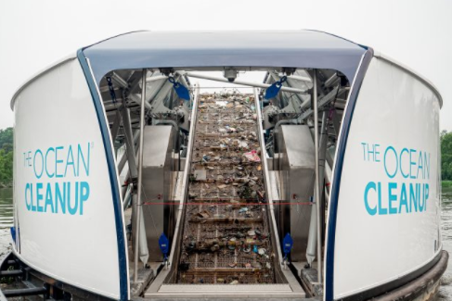
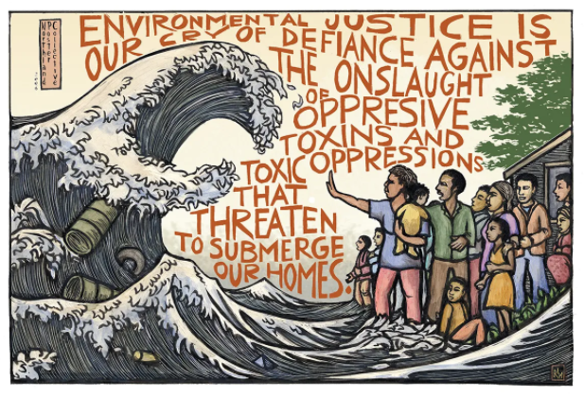
2021-2022 ESC Guest Speakers
Oct: Barry Simon, UN Association SoCal
Nov: Curie Canuela, CalRecycle
Sep, Dec: Rolando Cruz, Culver City Department of Transportation
Feb: The Ocean Cleanup “Interceptor”
March: Doyin Richards, Environmental Health
Apr: Sandrine Cassidy live at CCHS
May: Wendy Hamill, CCEF - MAY 26TH AT 5PM

Slide 13


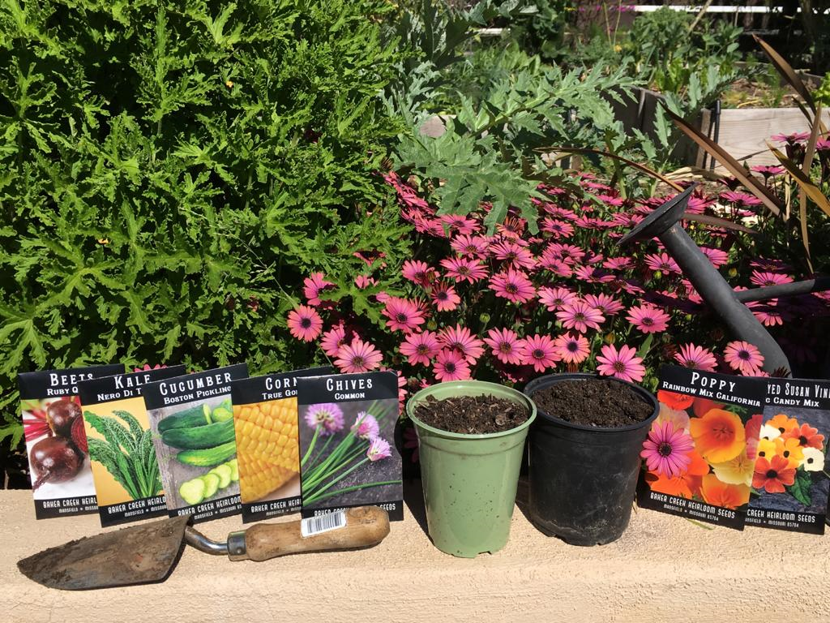

Best Practices for Sustainability
Best practices for Waste
Best practices for Water
Best practices for Energy
Learn about CCUSD!

Slide 14
Funding Sustainability at CCUSD
Sustainability Coordinator position
Position is not guaranteed and negotiated every year.
Quarter-time: $25,000 budget (there are 2 of us!) > FULL-TIME NEEDED
Why is it important?
Identifies sources of savings, every year w/ long-term implications
The bandwidth is not always there to identify these areas.
Lead and support many district-wide infrastructural projects in each school
Supports education/environmental justice
Other school districts w/ F/T: SMMUSD, SBUSD, LBUSD,...
Funding has come from: CCEF and previously Sony. Thank you!
Writes, applies, receives and implement grants
GND: adopted and in our fabric now.
Example: UUT TAX. Recouping up to 3 years of tax exemption. That’s 40K
savings moving forward!
So much potential to prepare our district and
students to face climate change!
See our list of potential available grants here.

Slide 15
Honoring the Environment in our Mission Statement
District Mission
The Mission of the Culver City Unified School District, a diverse haven of excellence, is to ensure that each student possesses the academic and personal skills necessary to achieve his/her highest potential as a valued, responsible member of society and steward of the Earth by providing challenging, personalized educational experiences in a safe, nurturing environment and by fostering a passion for teaching and learning with committed parent and community involvement.

Slide 16
Honoring the Environment in our core beliefs
DISTRICT’S CORE BELIEFS
Each person deserves to be safe
Everyone deserves to be treated with respect
Honoring diversity makes us stronger
Peace is worth pursuing
The quality of life is determined by the harmony among emotional, physical, spiritual and intellectual pursuits
Everyone has a right to a belief system
Aesthetics is essential to life
We are responsible for ourselves and accountable to each other
Individuals have the right to express their views, opinions, and thoughts
The sense of family and belonging is integral to our lives
We are committed to preserving the environment for future generations
Everyone has the right to preserve his/her dignity
Each person has the capacity for goodness

Slide 17
Contact us
JOIN US on Facebook! CCUSD Green
Visit our webpage and resources at ccusd.org/sustainability
We need your help: please reach out if you would like to be involved in our projects
contact: sustainability@ccusd.org
THANK YOU!

