Slide 1
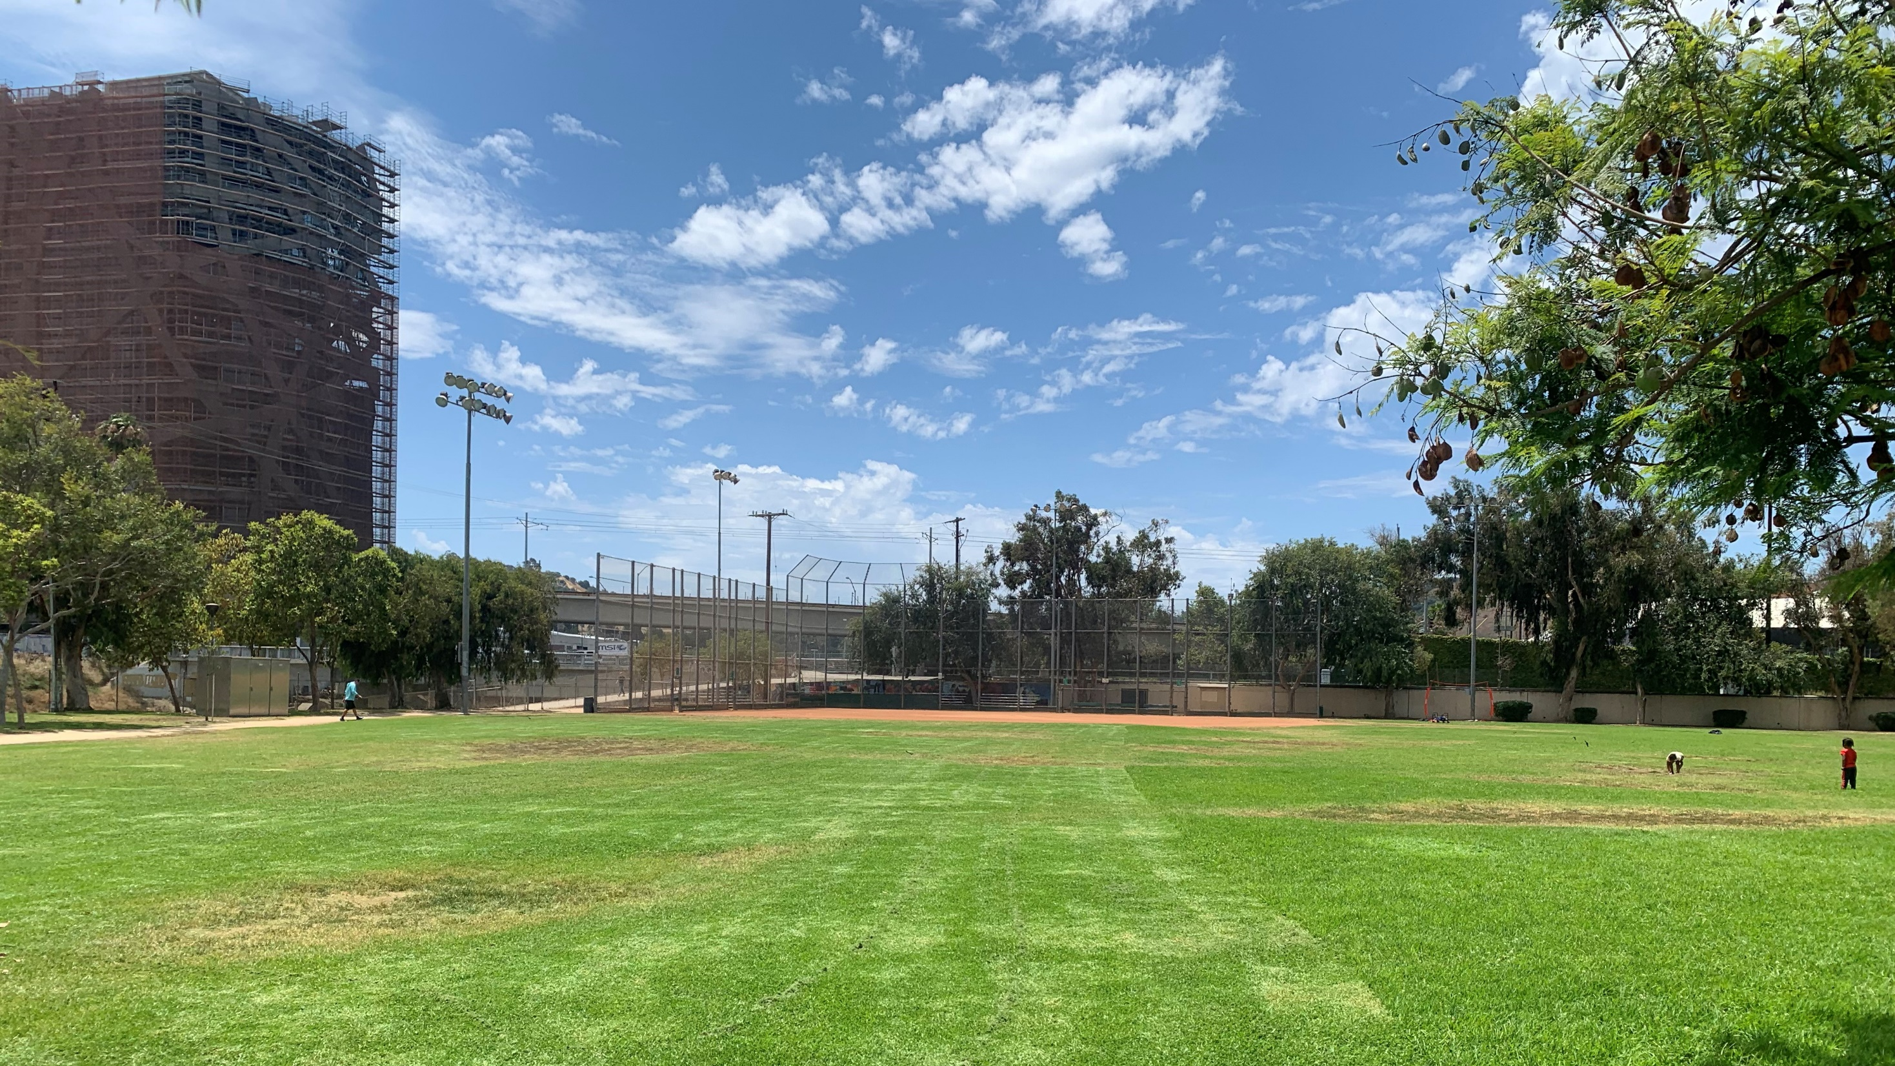
Syd Kronenthal Park
Stormwater Capture Project
Feasibility Study - Status Update
March 23, 2023
City of Culver City Sustainability Subcommittee
Presenter: Sean Singletary, Environmental Programs & Operations Manager, City of Culver City Department of Public Works

Slide 2
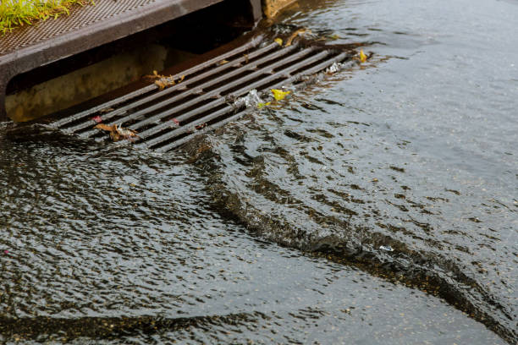
Background
Urban runoff from rainfall or
dry-weather water waste flows into Ballona Creek and eventually the ocean through the Municipal Separate Storm Sewer System.
During this process, pollutants can mix with urban runoff, causing damage to aquatic life and potential health risks to humans.

Slide 3
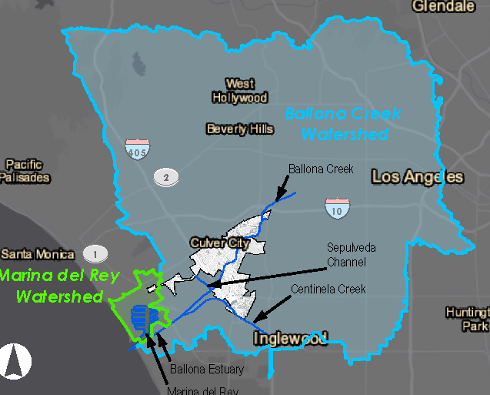
complying With Regulations
Multiple entities regulate and provide oversight on stormwater management, including:
National Pollutant Discharge Elimination System permit program
Ballona Creek Watershed Management Group
Santa Monica Bay Restoration Commission
Santa Monica Bay Groundwater Sustainability Agency
Los Angeles Regional Water Quality Control Board (MS4 Permit)
Central Santa Monica Bay Watershed Area Steering Committee (Measure W)

Slide 4



Stormwater quality Master plan
COMPLIANCE
FUNDING
Identify pathways toward stormwater quality regulatory compliance
Identify project and partnering opportunities to supplement and leverage Measure CW and Measure W revenue
DECISION TOOLS
Develop priority scenarios for project implementation and spending
Notes:
To focus our stormwater efforts, we underwent the plan in 2019.

Slide 5
Prioritizing Projects
Analyzed sites Citywide by many factors including:
  Drainage Area
  Land Uses
  Groundwater
  Soil Types
  Storm Drain
  Localized Flooding
  Disadvantaged Areas

Slide 6
Prioritizing Projects
441 project opportunities were identified: Regional, Green Street and Low Impact Development Projects
69 acre-feet of potential project storage
Adopted by City Council in August 2021
The Top Priority Project was Syd Kronenthal Park
Added to City’s Capital Improvement Budget in FY 2022
The City applied for and received a Technical Resources Program (TRP) Feasibility Grant from Los Angeles County
The TRP kicked off in April 2022

Slide 7
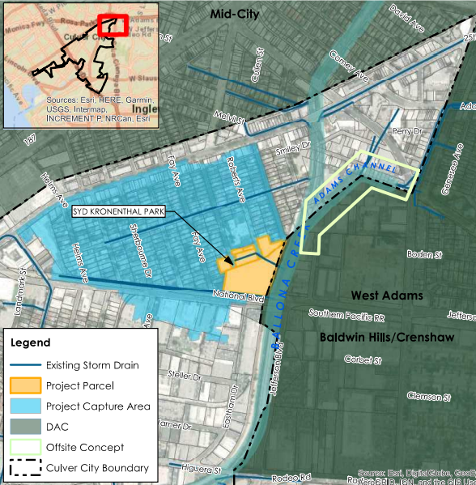
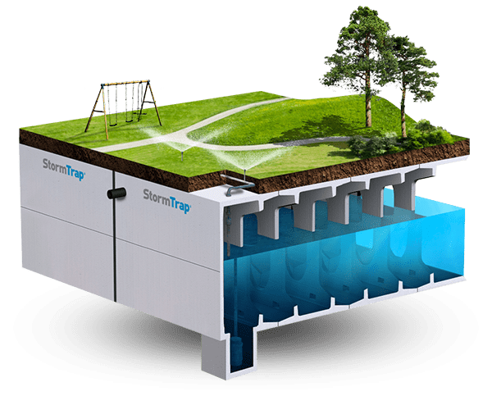
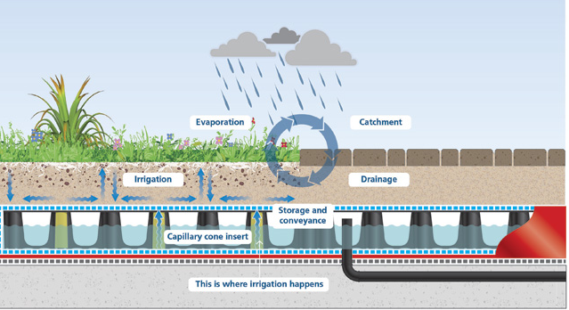
Concept in TRP application
1.2 acres Underground storage chamber and 2.0 acres permavoid irrigation shallow reservoir beneath Park grass and baseball fields.
Main St
S Fremont Ave
Hampden Terrace
Notes:
Located beneath the Park’s grass and baseball fields, the project initially focused on constructing a 1.2-acre underground storage chamber beneath the Park to capture and treat stormwater runoff from the roadway and surrounding neighborhood. The original concept from 2021, shown here, included the installation of 2.0 acres of a permavoid irrigation shallow reservoir beneath the Park but above the storage chamber to provide passive year-round irrigation. Utilities, delineations, and infiltration rates were evaluated through GIS analysis and best available data, after which a field survey was performed.

Slide 8
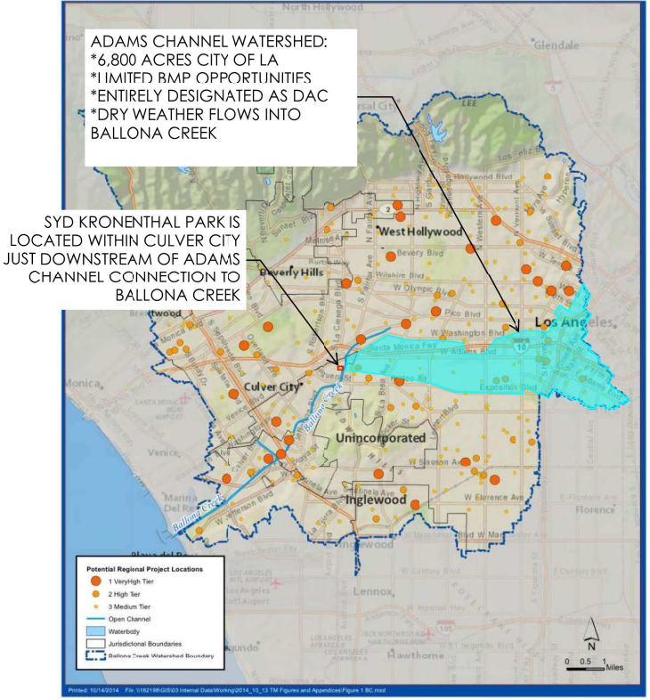
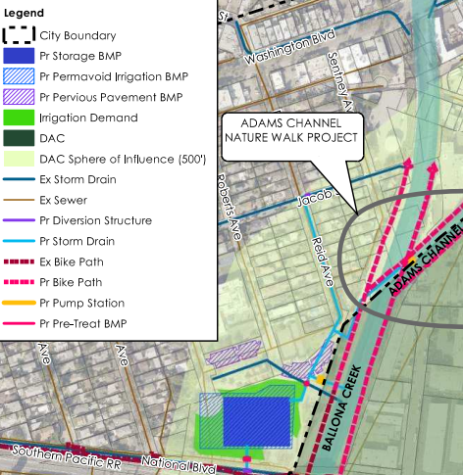
Concept in TRP application
Adams Channel Concept – Dry weather flow capture from 6,800 acres.
  Dry weather flows are the biggest contaminant for our natural water bodies is Southern California and include runoff from over-irrigation, car washing, and other urban discharges.
Main St
S Fremont Ave
Hampden Terrace

Slide 9
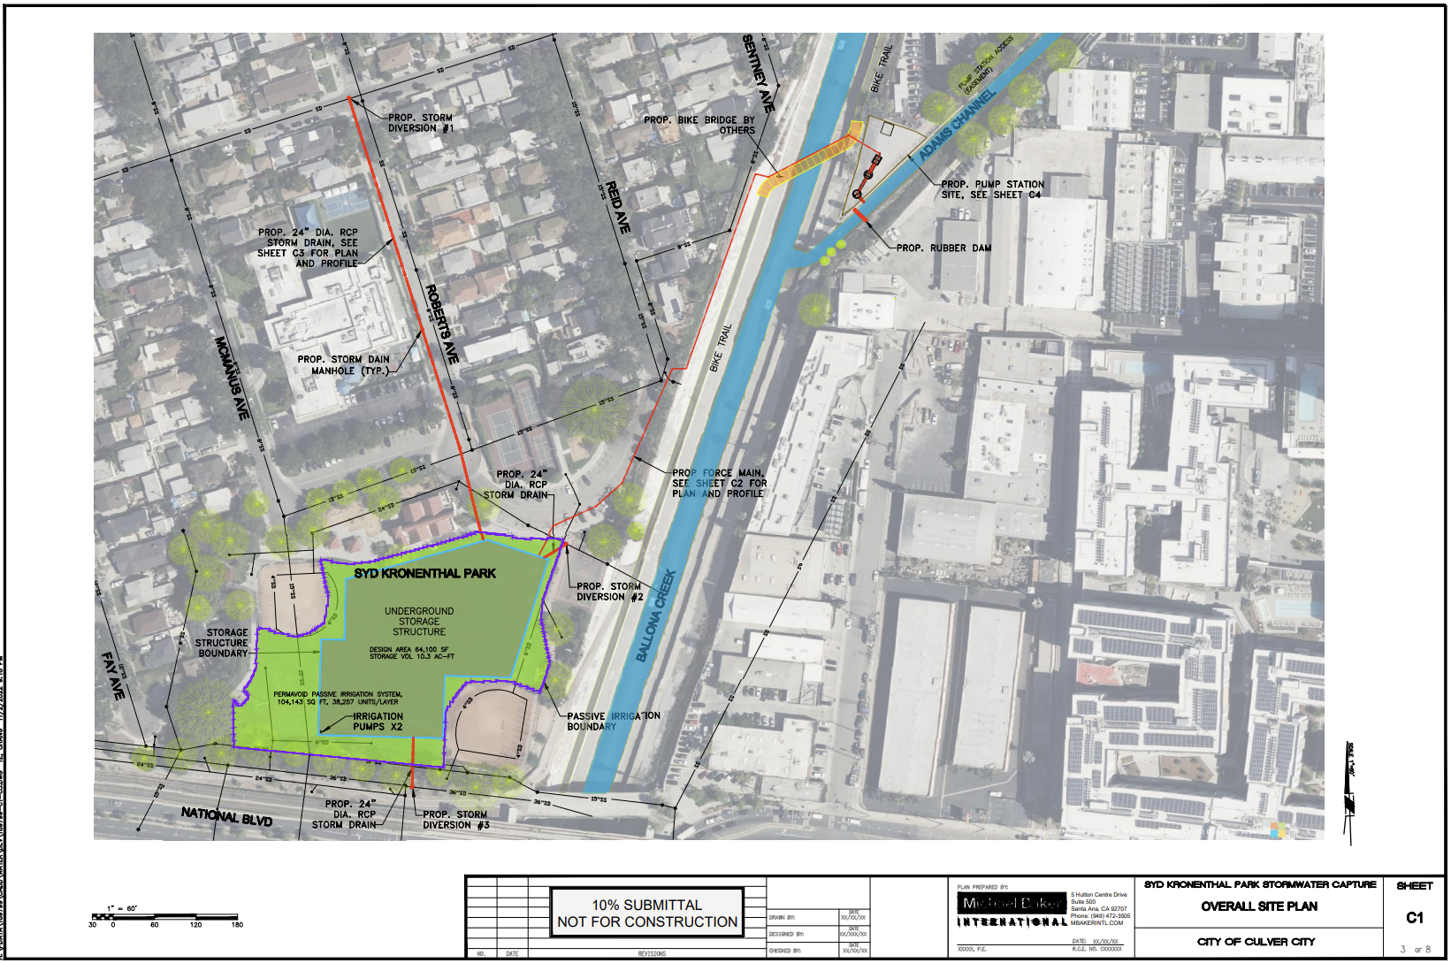

Slide 10
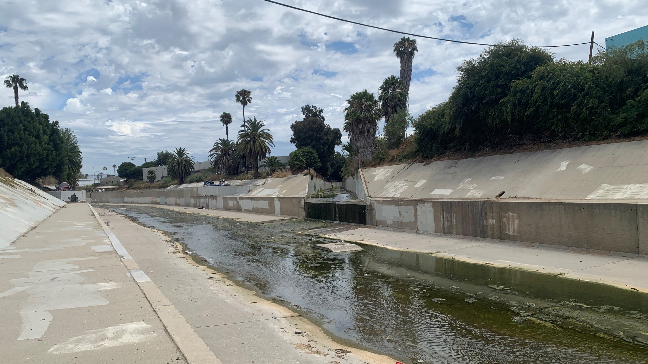
Adams Channel confluence with Ballona Creek

Slide 11
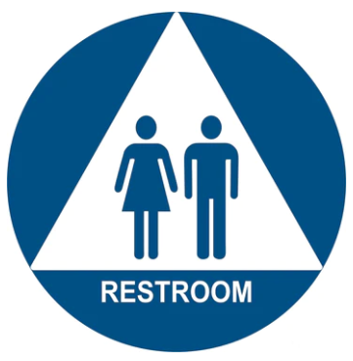
Primary Treatment – Capture and Use
Notes:
Bioswales/Rain Gardens
Educational signage

Slide 12
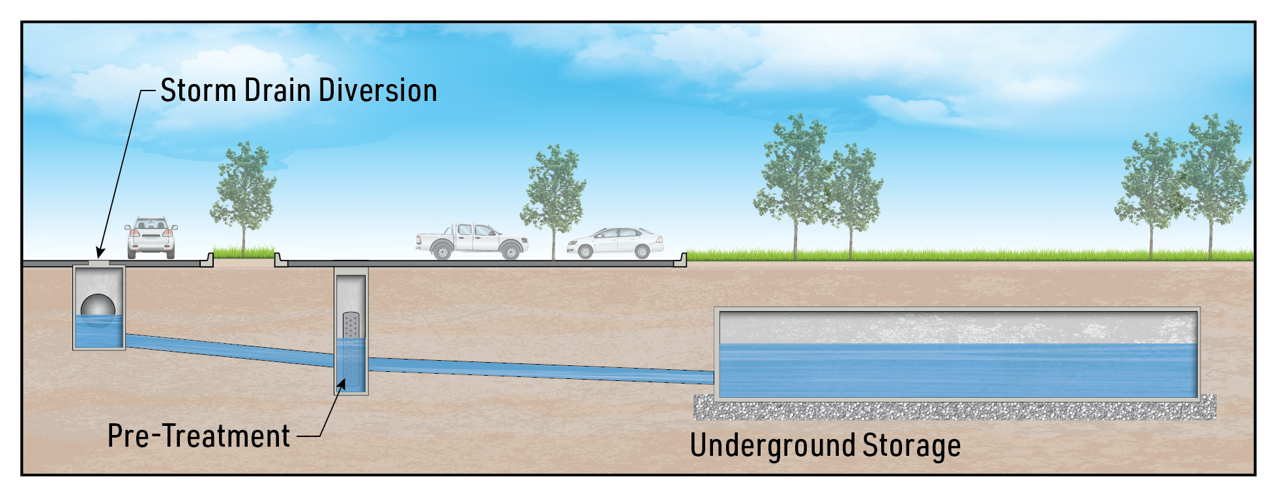
Secondary Treatment Alternatives - Infiltration

Slide 13
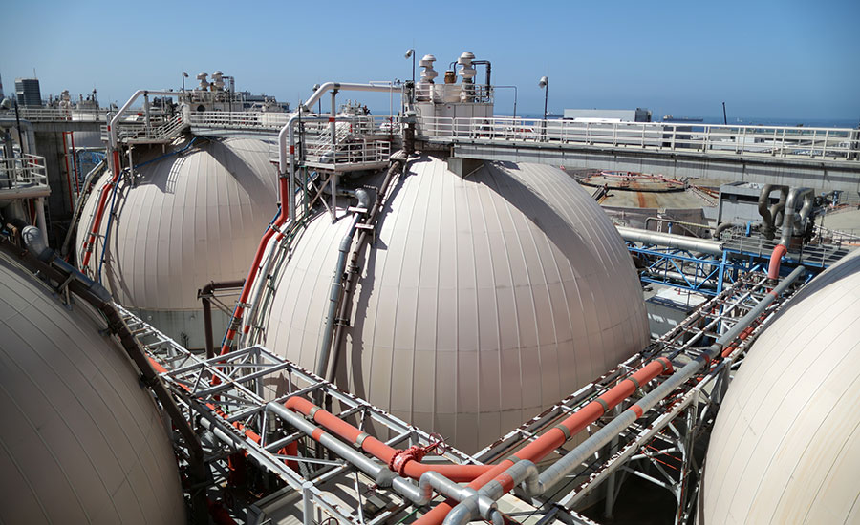
Secondary Treatment Alternatives - Divert to Sewer
Hyperion Treatment Plant

Slide 14
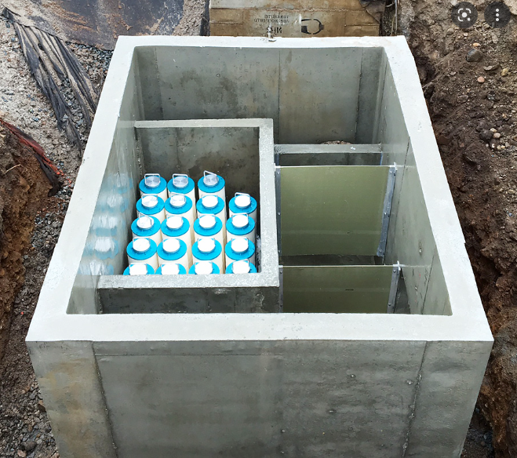
Secondary Treatment Alternatives - Treat and Release
Treatment Device

Slide 15

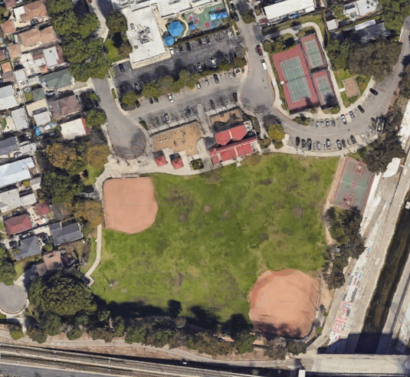
Estimated Project Timeline
2022 |  |  |  | 2023 |  |  |  |  |  |  |  |  |  |  |  | 2024 |  |  |  |  |  |  |  |  |  |  |  | 2025 |  |  |  |  |  |  |  |  |  |  |  | 2026 |  |  |  |  |  |  |  |  |  |  |  | 2027
Sep | Oct | Nov | Dec | Jan | Feb | Mar | Apr | May | Jun | Jul | Aug | Sep | Oct | Nov | Dec | Jan | Feb | Mar | Apr | May | Jun | Jul | Aug | Sep | Oct | Nov | Dec | Jan | Feb | Mar | Apr | May | Jun | Jul | Aug | Sep | Oct | Nov | Dec | Jan | Feb | Mar | Apr | May | Jun | Jul | Aug | Sep | Oct | Nov | Dec | Jan | Feb | Mar | Apr
Feasibility Study
 |  |  |  |  |  |  |  |  |  |  | SCW Project Selection
 |  |  |  |  |  |  |  |  |  |  |  |  |  |  |  |  |  |  |  |  |  |  |  | Project Design & Community Outreach
 |  |  |  |  |  |  |  |  |  |  |  |  |  |  |  |  |  |  |  |  |  |  |  |  |  |  |  |  |  |  |  |  |  |  |  |  |  |  | Contracting
 |  |  |  |  |  |  |  |  |  |  |  |  |  |  |  |  |  |  |  |  |  |  |  |  |  |  |  |  |  |  |  |  |  |  |  |  |  |  |  |  |  |  |  | Project Construction
Approx. Facility Access During Construction
Accessible During Construction
Construction Area – No Access
Notes:
Seeking project funding partners – Caltrans is interested.

Slide 16
Status
Desktop analyses (completed)
Site visit (completed)
Hydrology report (completed)
Geotechnical report (completed)
Public Outreach (in progress)
Environmental & Permitting (in progress)
Plan development
Financial Partnership

Slide 17
Any questions?
  Sean Singletary, Environmental Programs & Operations Manager
  Sean.singletary@culvercity.org
  https://www.culvercity.org/City-Projects/PW-Project-Syd-Kronenthal-Park-Stormwater-Project

