Slide 1
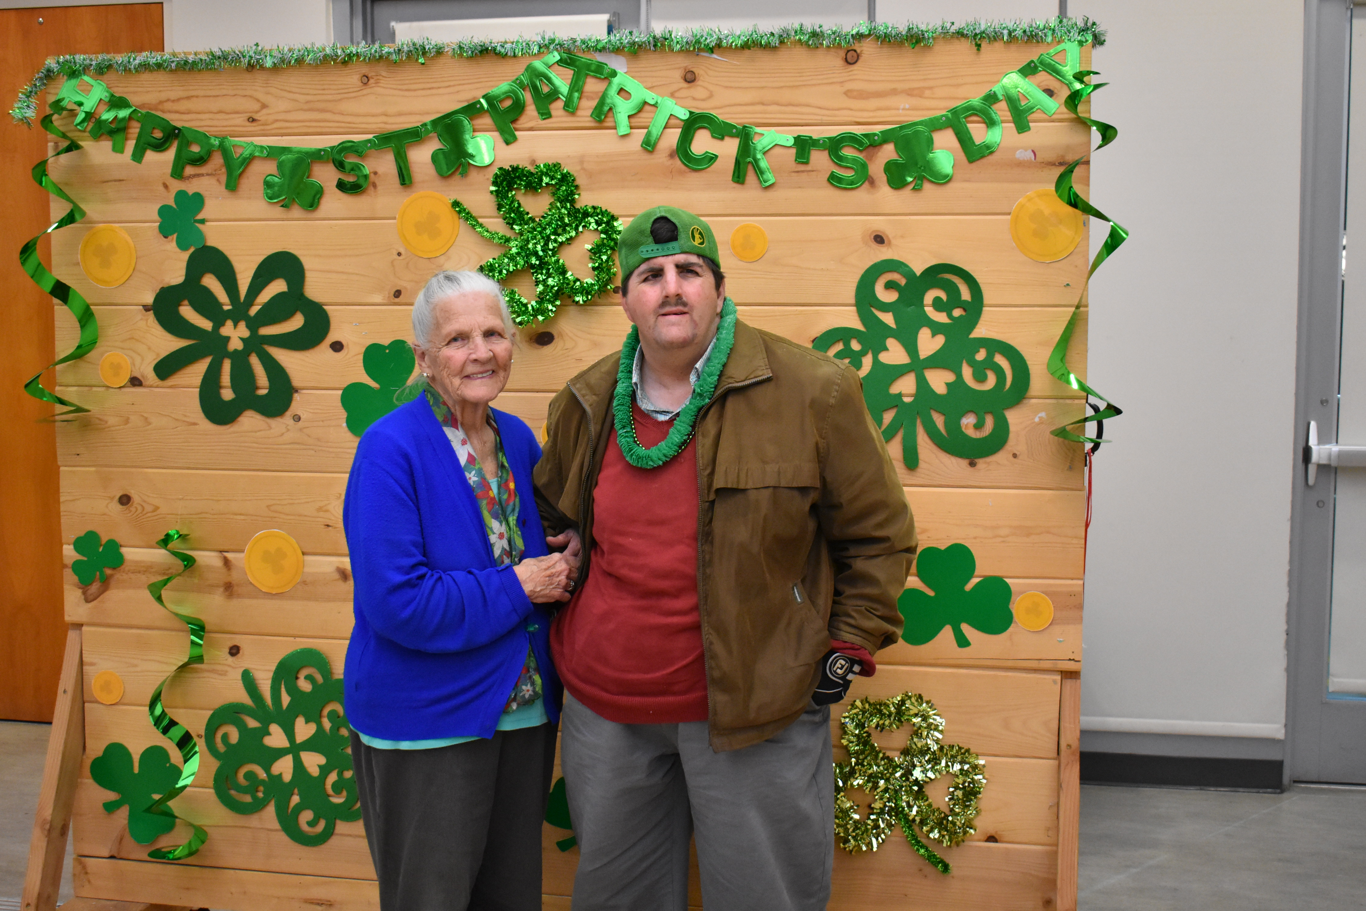
Socialites and DDD 2024

Slide 2
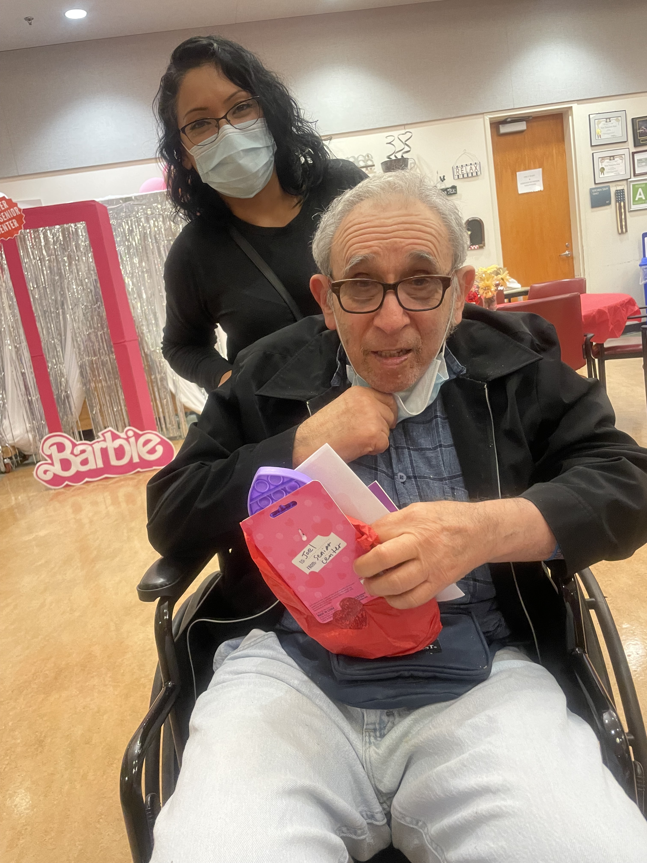
SOCIALITES AND DDD 2024

Slide 3

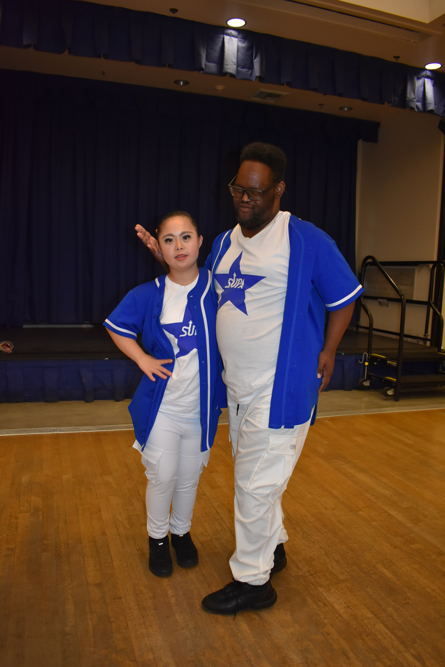
SOCIALITES AND DDD 2024

Slide 4
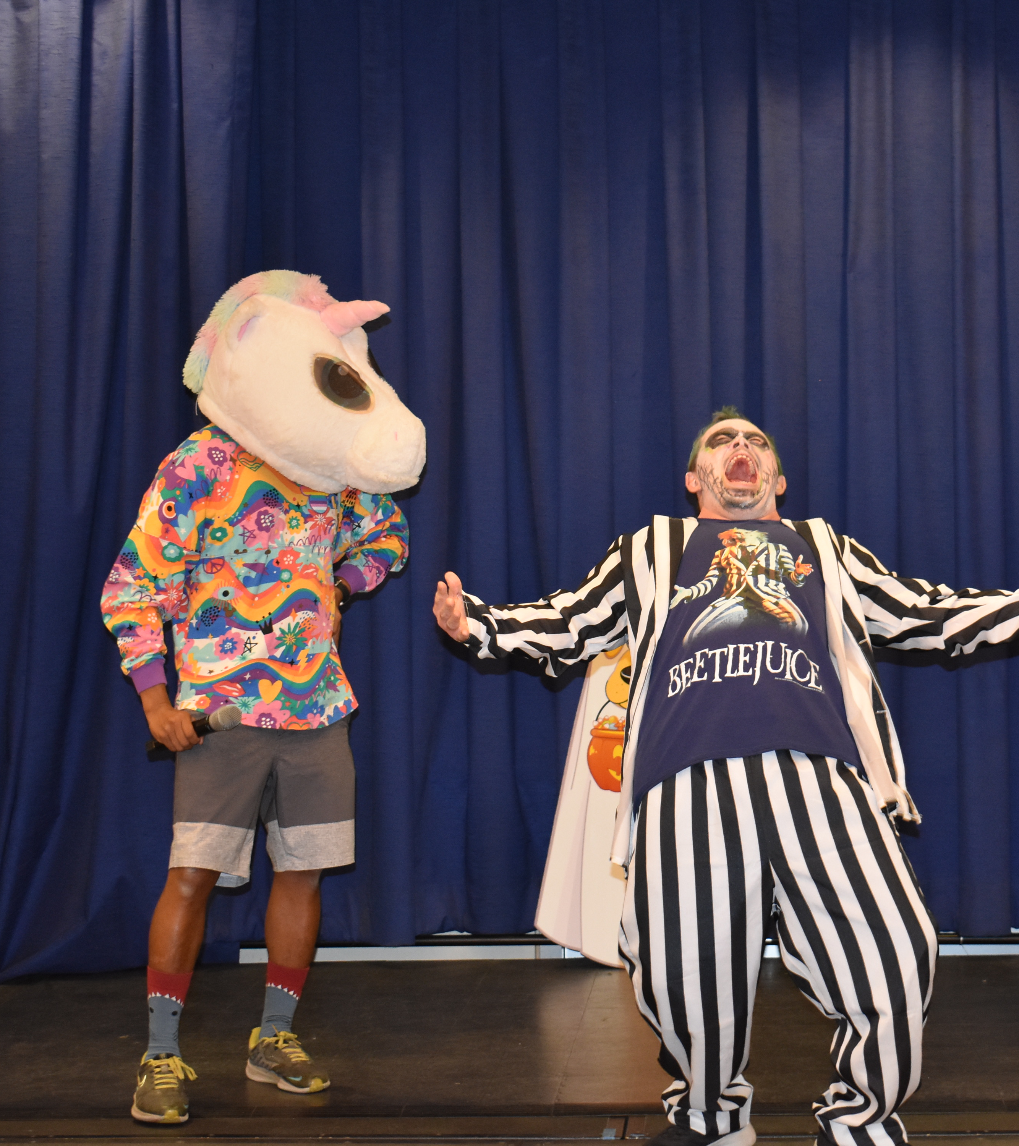

SOCIALITES AND DDD 2024

